Slide 1

Welcome
EIC EDGE – Week 1 Software Development Methodology
Notes:
Mandatory
ACTION: Adjust title to fit your course.

Slide 2


Hello
About me...
25+ years in the indusry
20+ years in teaching
Certified Cloud architect
Passionate about learning
Also, passionate about Reese’s Cups!
Allen Sanders
with DevelopIntelligence, a Pluralsight Company.
Notes:
Mandatory
ACTION: Adjust objectives to fit your course.
Script: I am [insert name] with DevelopIntelligence. We’re the training partner for [insert client name]. [Provide brief info on your background.]
Wing it!!! Keep it short!!! (Under 2 minutes; less than 1 is even better). Your goal is to establish rapport. You’re just trying to connect with the students. For example...
Here’s a little about my background in case you want this for reference later. Fun fact: [insert a piece of trivia about your personal life…”When I’m not teaching or coding, I am a skydiver”…whatever cool hobby you are engaged in]
Avoid putting your resume here. Say only a sentence or two about your professional credentials and invite them to ask questions about your background or experiences at any point during the training.

Slide 3
Prerequisites
This course assumes you:
Have some education and experience in Computer Science and software development
Have completed basic onboarding

Slide 4
Why study these subjects?
Quality software engineering is built upon a solid software development methodology
Knowing how iterative software development works helps you confidently contribute from your role
Understanding Agile principles helps you work more effectively in teams
Understanding DevOps (and DevSecOps) orients you to Capital Group’s tech culture and enables secure continuous improvement
Being familiar with JIRA and how it’s used helps you create, track and contribute to technology workflows
Knowing how to use GitHub positions you for divide-and-conquer on project completion

Slide 5








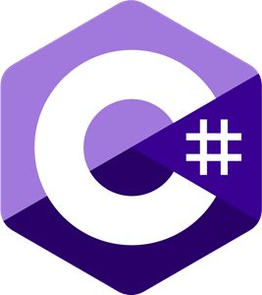



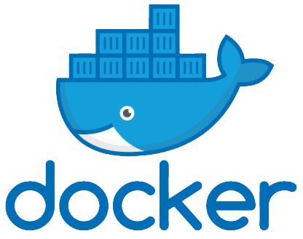




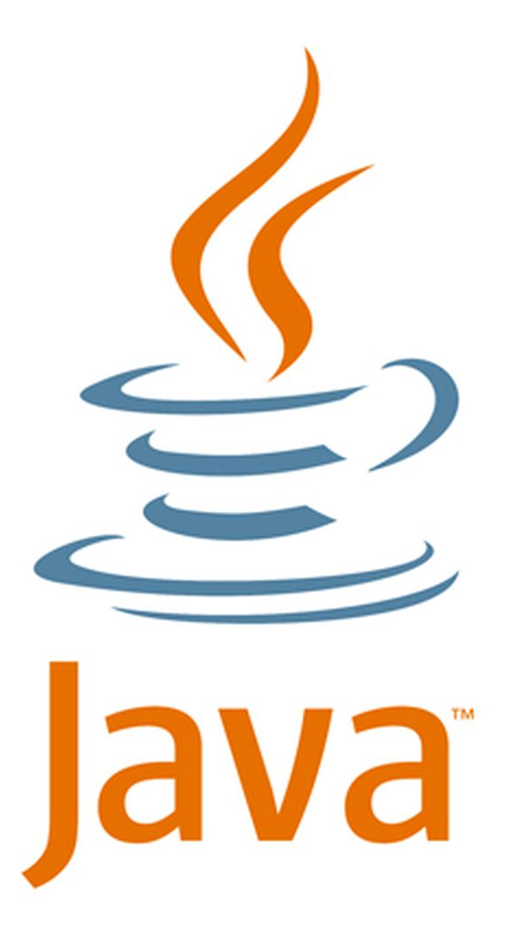






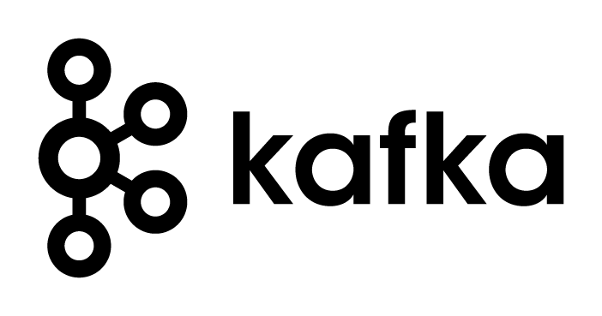
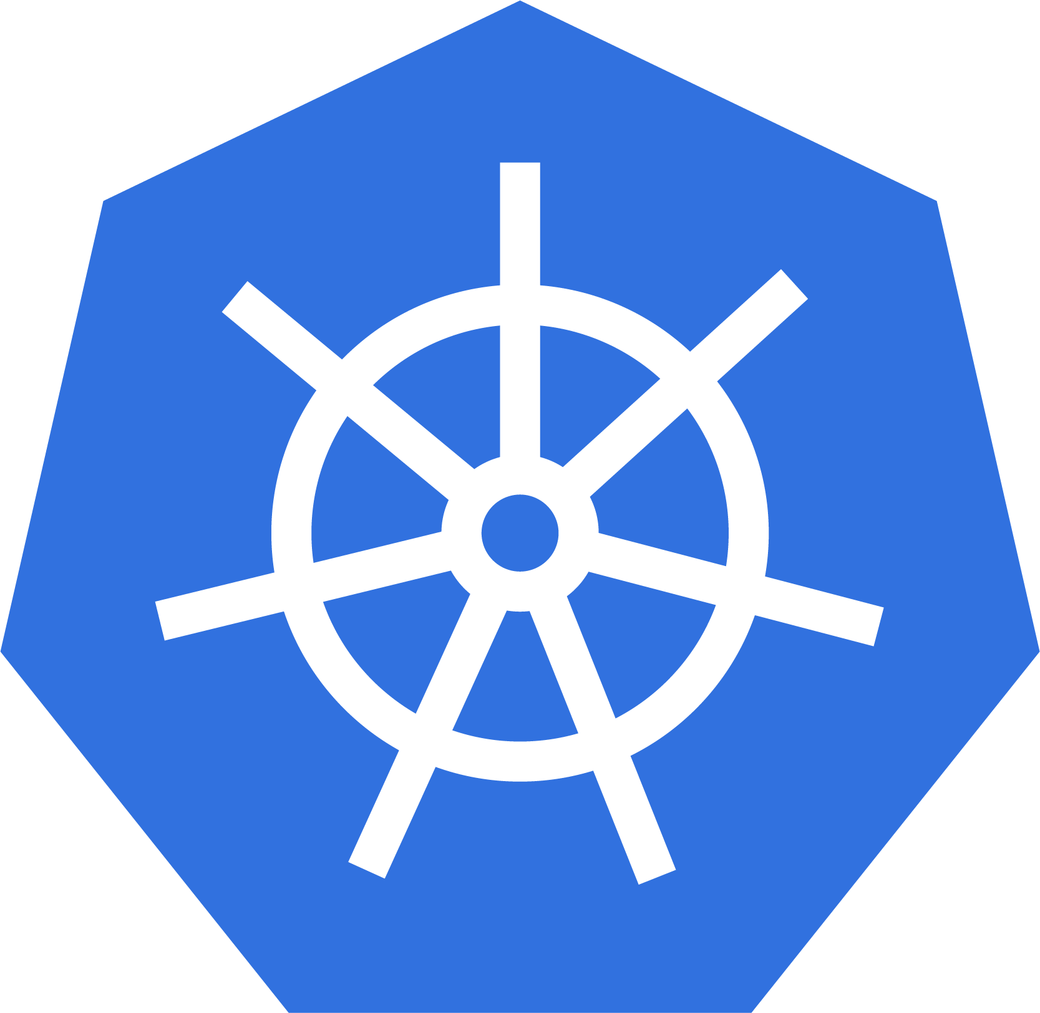

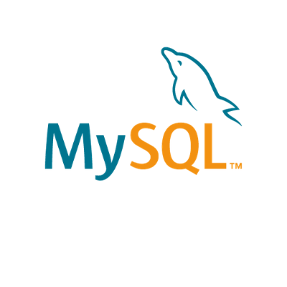

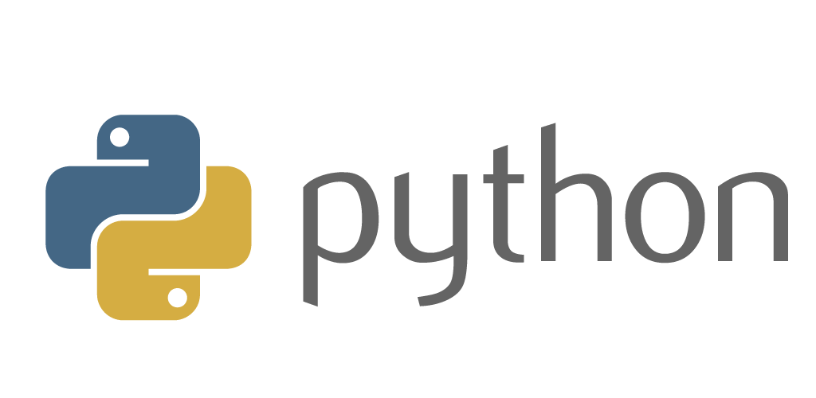
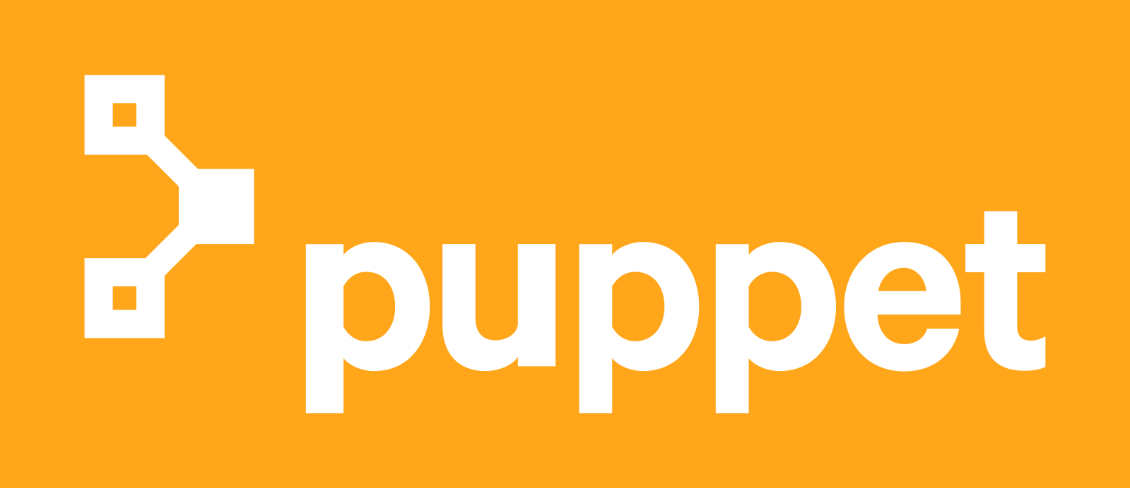


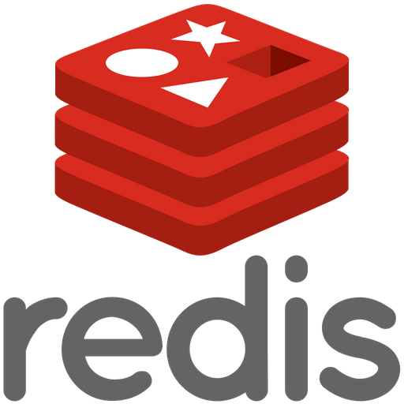




We teach over 400 technology topics
Notes:
Mandatory
Script: DevelopIntelligence teaches a lot of different tech. If there’s a technology you want to learn and you don’t see it in your company’s learning catalog, let your manager know. We’d be glad to help.”

Slide 6



You experience our impact on a daily basis!
Notes:
Mandatory
Script: In your everyday life, you come across tech many times a day. When you shop online. When you pay for your morning coffee. When you watch a movie or travel. We train software developers and IT professionals who work on many of the products and services you use daily.
In fact, when you talk on the phone, watch a movie, connect with friends on social media, drive a car, fly on a plane, shop online, and order a latte with your mobile app, you are experiencing the impact of our solutions.

Slide 7
My pledge to you
I will...
Make this interactive
Ask you questions
Ensure everyone can speak
Use an on-screen timer
Notes:
Mandatory
Script: This is my pledge to you. I’d like to talk in particular about the third bullet. Sometimes in a class, an enthusiastic participant will want to speak out in every discussion, answer every question and so forth. I want to make sure all of you have the opportunity to be heard. So, if I haven’t heard from you in awhile, I may call on you or check in via chat, because I want to make sure everyone gets their questions answered. Also, I want to demonstrate the timer and confirm that everyone can see it. EggTimer is a good timer - https://e.ggtimer.com/

Slide 8
Objectives
At the end of this course you will be able to:
Describe key aspects of iterative software development and understand your role in the process
Participate in Agile work efforts in a confident and meaningful way
Understand and help to improve the DevSecOps culture at Capital Group
Work within JIRA to manage work and break down complex tasks
Use GitHub to effectually manage important source code assets
Notes:
Mandatory
ACTION: Adjust objectives to fit your course.
Use measurable objectives that start with action verbs such as: describe, define, identify, assess, demonstrate, use, utilize. https://elearningindustry.com/writing-learning-objectives-for-elearning-what-elearning-professionals-should-know

Slide 9
Agenda
Day One
Software development methodologies and iterative software development
Software Development Lifecycle (SDLC)
Day Two
The Agile Manifesto and best practices in Agile/Scrum
Working with JIRA
Notes:
Day 1 - Software Development Methodologies + SDLC (don't use Scrum Master, use Scrum Lead)
Scrum
Ceremony (sprint planning, backlog grooming, retros, demos)
Pointing (Fib or similar for relative sizing)
Real life examples to include to make less theoretical
Day 2 - Agile Manifesto + Best Practices, Working with Jira
Focus more on best practices & why behind it
Iterative approach to software development
Incremental improvement
Working with Product Owners/Product Managers

Slide 10
Agenda
Day Three
Introduction to DevSecOps
Introduction to Test-Driven Development (TDD)
Day Four
GitHub Part 1
Day Five
GitHub Part 2
Notes:
Day 3 - Intro to DevSecOps, Introduction to TDD (Automated Testing Concepts, Tools, and FWs)
Shifting left
Static + Dynamic scans
Container scans?
Code quality - code coverage, cyclomatic complexity, unit tests passing, etc.
The 3 Laws
Code coverage
Technical debt
Motivation for automated testing
Days 4,5 - GitHub (Version Control, Branching, Tagging)
Version control
Branching
Tagging
Pull requests

Slide 11
How we’re going to work together
Lab work will take place in individual workspaces – isolated, browser-based virtual machines
Classroom labs may include individual work as well as group discussion and work
I welcome being interrupted – if you need more info, or clarification, or anything else, just break in and ask. I am here to help you.
Notes:
Mandatory
ACTION: Adjust bullets as per your course.
In this section, discuss the structure of the course—exercises, labs, etc.
Also, discuss any resources students will be using.

Slide 12
Software Development Methodologies and Iterative Software Development

Slide 13
Common Approaches to Software Development
Waterfall
Iterative

Slide 14
Waterfall Software Development
A sequential development process that flows like a waterfall through all phases of a project (requirements, design, implementation, testing, and deployment for example), with each phase completely wrapping up before the next phase begins.
Key aspects:
Majority of research done up front
More accurate time estimates
More predictable release date
Cons:
Process is brittle – can’t pivot easily in terms of changing requirements
Long lead times – difficult to respond to rapid business evolution
Tools:
Commonly use Gantt charts to track projects, subtasks and dependencies

Slide 15
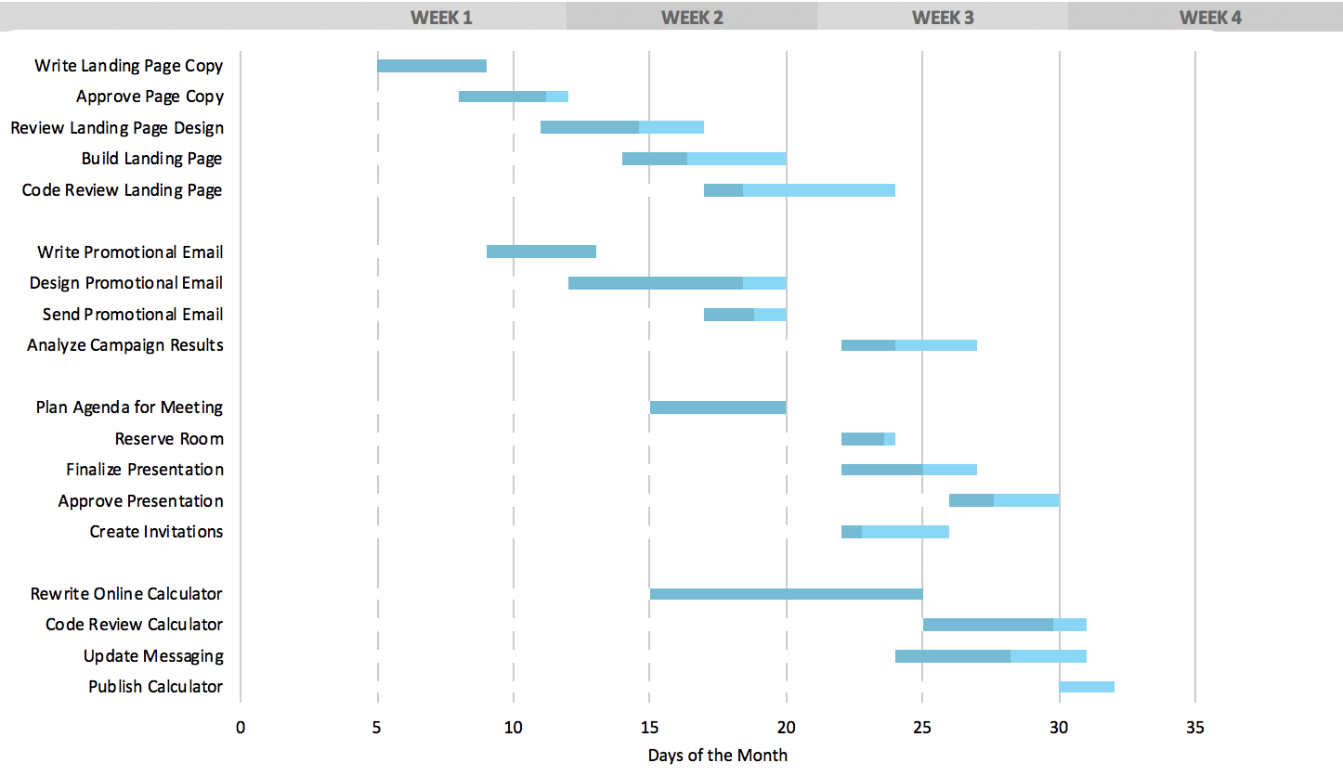
Typical Gantt Chart

Slide 16
Agile Software Development
A group of software development methodologies based on iterative development.
Requirements and solutions evolve through collaboration between self-organizing cross-functional teams.
Key aspects:
Incremental delivery
Always ready to ship
Continuous inspection of work product and process provides feedback for continuous improvement
We will explore Agile in more detail later in this class

Slide 17
ESSAY:
Describe the software development or project management approaches you have worked with, and your opinions on the pros and cons of each
Notes:
This shouldn’t be a long essay, and doesn’t need to conform to university standards ☺
It’s more important that you communicate how the systems worked, in plain language – and what it was like to work in those systems. Talk about WHY you think something worked well, or didn’t
Please write your essay in a .txt file and send it to the instructor
Your experience with various software development systems (3-5 sentences)

Slide 18
Iterative Software Development
Key elements:
Incremental improvement to code and process
Always ready to ship
Iterative feature development
Working with the Product Owner
Pivoting mid-development

Slide 19
Incremental improvement to code and process
Principle: Using feedback obtained from regular examination of product and process lets you incrementally improve both
Key aspects:
Work in short cycles (1-6 weeks) composed of overlapping phases: requirements, design, programming, testing.
Build on what was built before and produce a working product at each stage. Gather customer feedback at the end of each iteration.
Each iteration, evaluate the team’s performance. Change internal process as needed to improve quality of estimation and delivery.

Slide 20
Always ready to ship
Principle: after the first iteration, the product is always "ready to ship". That is, the product does something useful and is in a releasable state.
Key aspects:
This is a risk mitigator – if the project is cancelled or greatly reduces in scope, there is still something of value to show for the work efforts
Projects are less likely to be cancelled, as there is always a working product that shows the project’s value and the team’s competence
Key practices that support this principle:
Do daily software builds
Fix bugs right away
Relentlessly use automated testing to mitigate regression

Slide 21
Iterative Feature Development
Principle: Instead of building all features and then releasing (waterfall), instead develop one feature, then the next, always keeping the application in a shippable state. Continually re-assess priority of feature development, including refinement of existing features, based on feedback
Key aspects:
It is important to work closely with all concerned parties for a system like this to work, and for all involved to understand that development on the application will be iterative – the form of the app presented in one iteration doesn’t necessarily represent the final form of the app, and should not be evaluated as such. Instead, meaningful feedback will allow rapid modification of a feature, while new features are iteratively added to the app
Key practices that support this principle:
Set expectations for all stakeholders
Educate stakeholders on iterative development so they are effective contributors
Be willing to change

Slide 22
Working with the Product Owner
Principle: working closely with the Product Owner enables the incremental production of shippable features that are valuable to the end user
Key aspects:
Consult with the product owner before each iteration, agreeing on the scope and details of work for that iteration.
During the iteration, the external customer or project manager cannot change the scope for that iteration, but the development team may change the scope by dropping features if the end date will not be met.

Slide 23
Pivoting mid-development
Principle: An agile, iterative process can allow a project to pivot in small or large degree, mid-process, without excessive cost of time or resources
Key aspects:
Manage to meet business goals, due dates and budgets. Be willing to change requirements to fit these, not the other way around.
Learn as you go; be adaptable to new or changing business needs that become clear only after development begins.
Analyze existing implementations frequently to determine that they are meeting business goals.

Slide 24
LAB:
We will use a simple Python application for all of our practical work throughout the training. Here, we will examine a running example, then install it locally and get it running.
Notes:
Full-stack app
Back end is written in Python and uses flask web framework
Front end is written in JavaScript and uses React
Review and install the “Reference Implementation” for our training

Slide 25
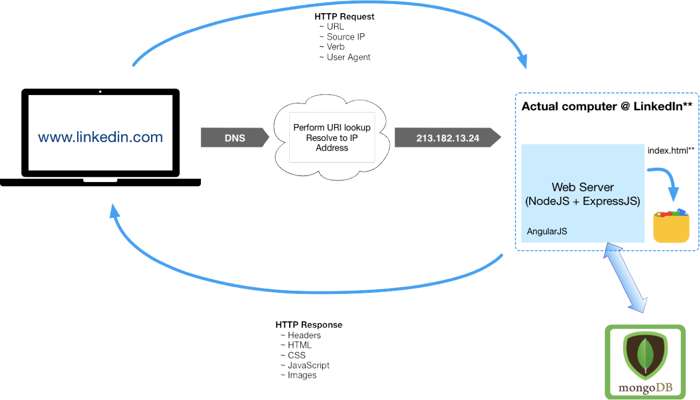
Elements of a Full-Stack App and HTTP Request/Response Cycle

Slide 26
WORKSHOP:
Group discussion considering the Reference Implementation from the following points of view:
What might an iterative approach to the Reference Implementation look like?
What features should ship first?
How might it pivot, based on market or other factors?
Looking at the “Reference Implementation” from an iterative approach

Slide 27
Software Development Lifecyle (SDLC)

Slide 28
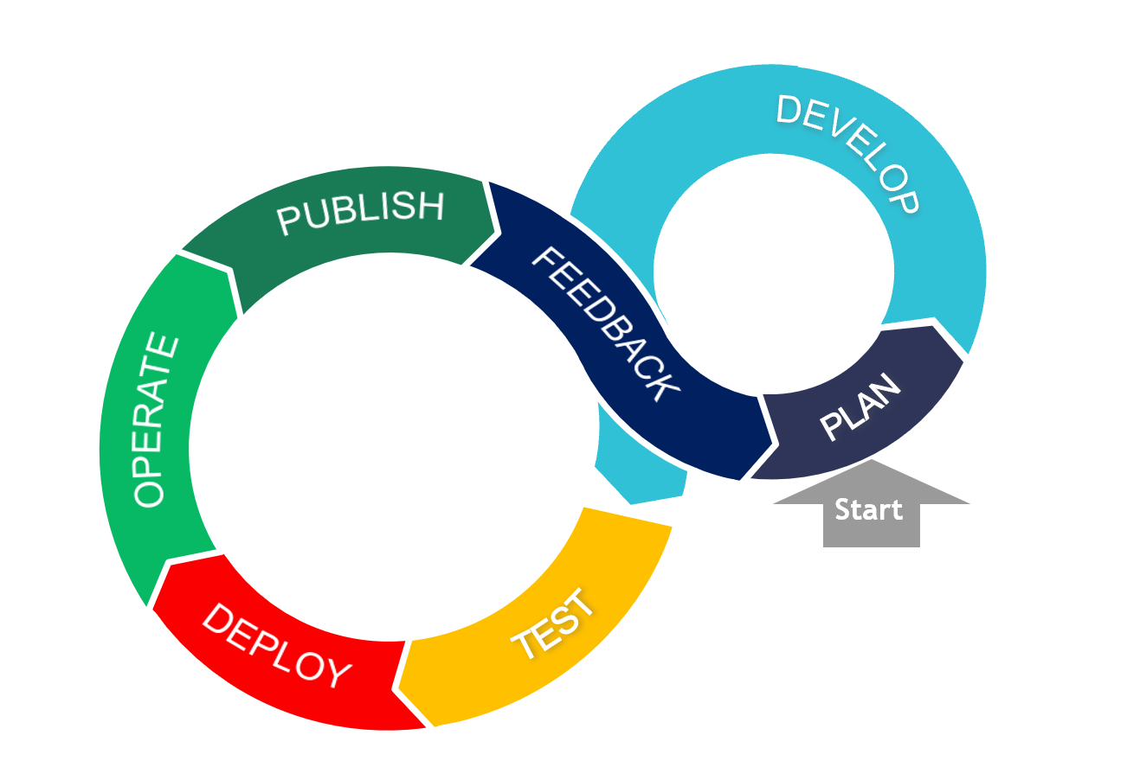
Agile Software Development Lifecycle (SDLC)

Slide 29
The Agile Manifesto and Best Practices

Slide 30
The Agile Manifesto and its Origins
What is it? A statement of values regarding approaches to how teams create and ship software
When was it made? 2001, by 17 top software developers and consultants
Key aspects:
12 values were agreed upon
These values are NOT a process, implementation or standard; they are opinions
Many popular project management methodologies have arisen that are based on these values
Many Agile implementations are poorly executed; it takes great cooperation between business leadership and a competent, self-guided dev team to make it work

Slide 31
Agile Values
Individuals and Interactions > Processes and Tools
Working Software > Comprehensive Documentation
Customer Collaboration > Contract Negotiation
Responding to Change > Following a Plan

Slide 32
Key Elements of the Agile Approach
The Agile method is an iterative and incremental tactic to software design that utilizes constant planning, understanding, upgrading, team partnership, development, and delivery.
It is driven by the principles of providing value and collaborating with stakeholders.
It starts with customers defining the end uses of the final product and the kind of problems the final product attempts to address.
Designated teams start to plan and work on a complete process through planning, implementing, and appraising.
Since the development process is iterative, errors are resolved in the intermediate stage of the project.

Slide 33
Modern Approaches to Agile Software Development
Several project management approaches implement Agile values in some way. Often, they bring in elements of other approaches.
Popular methodologies:
Kanban – uses visual boards to view and organize tasks. Uses elements of “Just In Time” lean manufacturing strategies, emphasizing throughput
Scrum – aligns closely with Agile values. Breaks down overall development into iterative sprints. Makes use of exclusive roles (“Scrum Lead”, “Product Owner”) and emphasizes constant communication through a daily “scrum” where activities can be aligned.
Scaled Agile Framework (SAFe) – workflow and organizational patterns to help deploy Agile at scale in large organizations.
All three of these approaches are in use in some fashion at Capital.

Slide 34
Common Agile Practices at Capital Group
Common practices are:
Close collaboration between an engaged and knowledgeable Product Owner and a self-organizing dev team with strong ownership for code and team quality
Relentlessly working to break complex tasks down into smaller, more discrete and defined elements
Making use of Scrum boards to track and prioritize work
Sprints run using Scrum principles and practices Continuously evaluate and improve how we choose scope of work for each iteration

Slide 35
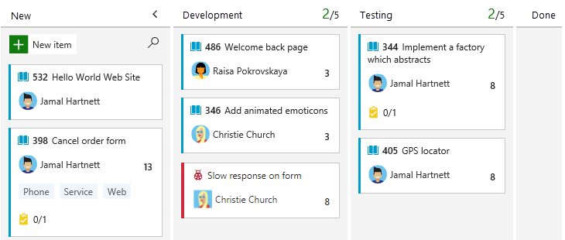
Typical Kanban Board

Slide 36
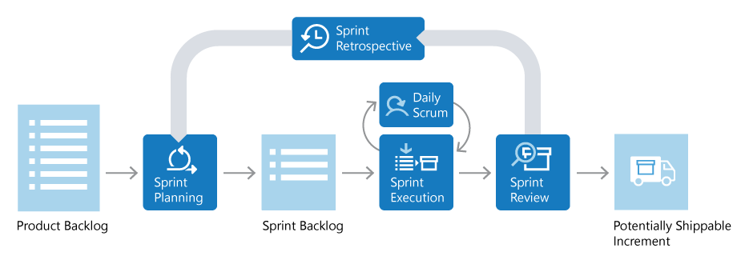
Diagram of Typical Scrum Sprint
Notes:
https://docs.microsoft.com/en-us/devops/plan/what-is-scrum

Slide 37
LAB:
Walk through a typical two-week Agile/Scrum Sprint. Key elements:
Sprint/Iteration
User Stories
Spikes/Epics
Backlog
Backlog and Grooming
Burndown
Definition of Done
Walkthrough of an Agile Sprint

Slide 38
Working with JIRA

Slide 39
Overview of Project and Issue Tracking Software
There are many applications in use to manage tech work – some oriented around service tickets; some around dev tasks, some around both
Popular project and issue tracking software:
JIRA
Asana
Trello
Monday
Zoho
There are MANY others; this is a crowded space
In dev work, integration with tools used in the full dev cycle is important – testing; deployment, monitoring, etc.

Slide 40
Overview of JIRA
JIRA is part of a family of products from Atlassian.
It can be configured to align with popular Agile methodologies.
Key functionality:
Provides a central hub for design, coding, testing, collaboration, release and maintenance
Integrates with CI/CD systems
Provides a feature backlog for planning purposes
Enables Sprint planning

Slide 41
Basic Building Blocks of JIRA
JIRA is built around three basic concepts:
Projects: A collection of Issues, all oriented to one product or work initiative
Issues: The basic element of work in JIRA. Includes the work to be done, as well as metadata about the work. This can be net new work, bug fixes, service tickets, etc. – any type of work
Workflow: A record of the life of an Issue. Issues can only have one state at a given time. Transitions from one state to another can be tracked and controlled as needed

Slide 42
DEMO:
Lifecycle of a JIRA Issue

Slide 43
Using a Scrum Board
Your Scrum board visually represents your workflow – the sequential state changes of your team’s work. A common configuration at Capital Group might be:
New Issues (in the form of features/stories/tasks/bugs, etc.) begin in a Product Backlog, as they are identified
In Sprint Planning, Issues are refined and moved into the Sprint Backlog
Whether assigned a work item, or pulling it yourself, the board lets you choose an Issue and move and then through the states in the defined Workflow for the Project
Often, your actions in other tools will result in a state change for an Issue; the board will update to reflect that change
Because so much of the work activities is tracked electronically, you can also use JIRA’s Control Center to view important metrics about the work of the team and of its members. It tells you about things like: How long an issue sits in a state; average time to complete an Issue; etc.

Slide 44
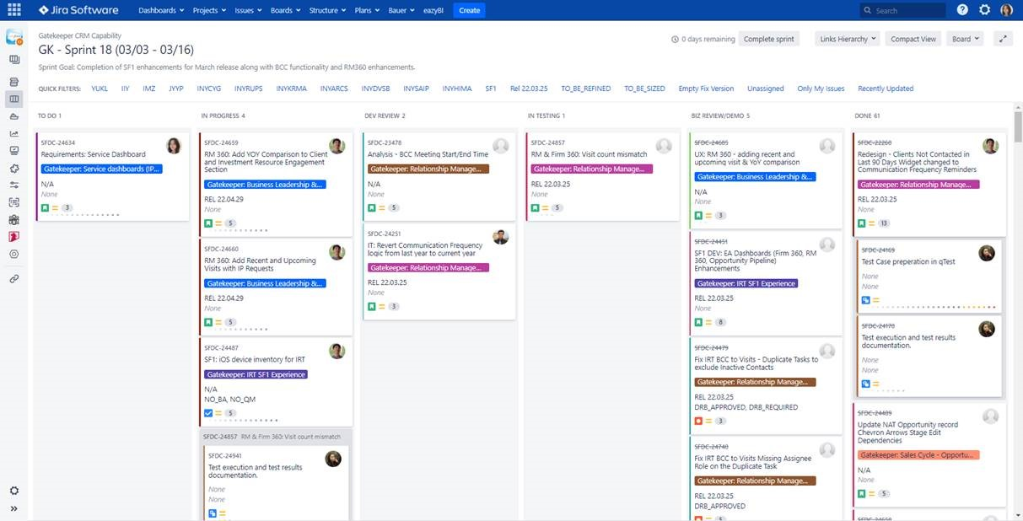
Example Scrum Board

Slide 45
Working With a Product Backlog
Because we use Agile values, and not Waterfall methodology, we need to continuously work with the items in the product backlog. For the most part, the Product Owner owns this backlog.
Mainly this involves two actions:
Re-evaluate the priority of the work items
Break down larger tasks into discrete, well-defined items that can be completed in one Sprint and which move the project forward while still maintaining an always-shippable product

Slide 46
LAB:
Breaking down a large story into smaller tasks

Slide 47
Introduction to DevSecOps

Slide 48
DevSecOps
What is it?
Disciplined build of security into all phases of SDLC
Just-in-time security assessment and testing
Security as a “shared responsibility”
Notes:
Distributes security concerns to all teams using tooling to help automatically fill in gaps in experience or understanding

Slide 49
Why is it important?
To maintain a competitive advantage:
We need to deliver software quickly
We need that software to have high quality
We need that software to be secure
DevSecOps
We want to merge speed & agility with security & quality!
Notes:
Automation with quality assurance built into the pipeline and security applied at each phase

Slide 50
DevSecOps and how can businesses benefit from it?
DevSecOps integrates software development with IT/SEC operations, leveraging automation to shorten the product life-cycle and enable frequent deliveries aligned with the business needs, while ensuring quality
DevSecOps Building Blocks
Impact Levers
Continuous integration
Automated testing and single source code mgmt. system
Speed
Release in days, not months
Continuous delivery
Ability to deliver software when ready
Quality
Enable speed and enhance stability with rigor and confidence
Continuous deployment
One-click release of software to live
Continuous monitoring and autonomic operations
Highly automated IT Operations, including security, vulnerability scanning
Efficiency
Operate in automated environment and focus on high value tasks
Standardized and automated infrastructure mgmt. with built in security
Automate environment with infrastructure-as-a-code (IaC),
Security
Baked-in and fully integrated into SDLC

Slide 51

Security in Software Engineering – The Traditional Way
Not enough time in schedule to absorb changes required to remediate
Activities required to remediate may be complex
Security issues require revisit of one or more previous phases

Slide 52
Security in Software Engineering – A Better Way

Slide 53
Security in Software Engineering – DevSecOps
SAST (Static Application Security Testing) and SCA (Software Composition Analysis) tooling
Monitoring & alerting, RCA (Root Cause Analysis)
Threat modeling, data protection, and risk assessment
Additional security-specific scanning, port scans, and log validation
DAST (Dynamic Application Security Testing) tooling

Slide 54

Security in Software Engineering – DevSecOps
Information gathered from early phases feed into later phases
In true DevOps fashion, lessons learned feed continuous improvement
Quality gates guard against moving security defects forward
SAST (Static Application Security Testing) and SCA (Software Composition Analysis) tooling
Monitoring & alerting, RCA (Root Cause Analysis)
Threat modeling, data protection, and risk assessment
Additional security-specific scanning, port scans, and log validation
DAST (Dynamic Application Security Testing) tooling

Slide 55

Shifting Security Left – Develop
Ideally, security flaws in code would be caught on a developer’s machine
Can use plugins for IDEs to provide automated static analysis
In some cases, tools can be configured with custom rules and priorities

Slide 56
Shifting Security Left – Develop
Rulesets and priorities should be driven by results of threat modeling
Scanning tools if used should be a standard part of all developer’s code tooling, to ensure consistently applied (standard dev build)
Goal is to catch issues VERY early on in the SDLC

Slide 57

Moment of Reflection
What is the most “secure” programming language in use in the industry today?
Type your answer in chat
Notes:
https://www.whitesourcesoftware.com/most-secure-programming-languages/

Slide 58
Shifting Security Left – Build
Changes from a developer are ready to be integrated with others
Typically driven through submission of Pull Request in GitHub
Notifies a peer that changes are pending and need review

Slide 59
Shifting Security Left – Build
In addition to logic/syntax errors, peer reviewer can focus on areas of high risk/high impact identified in threat modeling
In some cases, a specialist peer reviewer (e.g., one from InfoSec) can be engaged to validate security of code

Slide 60
Shifting Security Left – Build
Coupled with manual review, SAST (Static Application Security Testing) tools can be integrated into CI/CD to automate security checks
Tools like SonarCloud/SonarQube can be integrated into pipeline via plugins (https://sonarcloud.io/)
Some even include ability to capture scan results in resulting build report and use results of scan as quality gate to prevent move forward on failure

Slide 61
Shifting Security Left – Build
SCA (Software Composition Analysis) tools also provide benefit
Tools like WhiteSource (https://www.whitesourcesoftware.com/) can be integrated into CI/CD for automated security scans of Open-Source components
Ideally, governance would be in place to monitor and manage “accepted” set and versions of Open-Source tools approved for usage
Notes:
Like an artifact repository – e.g., npm modules, Docker images, Python packages, etc.
Developers and builds would pull from these repositories instead of the Internet

Slide 62
Shifting Security Left – Build
SCA tools can provide a couple of benefits
Primarily, security scans can be executed, and Open-Source vulnerabilities identified
Secondarily, can help an organization catalog the Open-Source components (and versions) “in play” already

Slide 63
Shifting Security Left – Build
Resulting report can be used to identify components that have not been properly vetted through governance
Results can be merged with overall build output
Quality gates (manual or automated) can be built around results to prevent move forward if insecure

Slide 64
Moment of Reflection
Answer the following question: Using an open-source library is more secure than building something custom? Yes or no, and why.
Type your answer in chat

Slide 65
Shifting Security Left – Test
Includes changes ready for move to QA for additional testing
Dynamic Application Security Testing (DAST) tools provide more sophisticated vulnerability checks
Dynamically exercise application’s runtime interfaces using injected data

Slide 66
Shifting Security Left – Test
DAST tools can use complex combinations of invalid input via fuzzing
Provides multiple layers of protection
A tool like OWASP Zed Proxy or OWASP ZAP is an example (https://www.zaproxy.org/)

Slide 67
Shifting Security Left – Test
Two types – passive scan and active scan
Passive scan less aggressive and minimizes use of fuzzing
As a result, not as robust in its ability to find exposure but also takes less time to run

Slide 68
Shifting Security Left – Test
Because of that, passive scan can be good fit for CI/CD pipelines, especially those that look to push updates at a greater frequency
For the C (continuous) part, need flows to complete quickly
Notes:
Quickly is relative

Slide 69
Shifting Security Left – Test
Active scans are more aggressive in their attack approach
Make extensive use of fuzzing to elevate level of attack sophistication
Send multiple requests, continually altering request data to simulate attack payloads

Slide 70
Shifting Security Left – Test
Can also make use of a technique called “spidering”
Allows the scan to crawl a site or service to simulate sequenced or multi-level attacks (stateful attacks)
Can be very effective in securing a site or service but also takes much longer to execute (due to added complexity and sophistication)

Slide 71
Shifting Security Left – Test
Because of its more aggressive nature, should only be executed against owned sites and in a sandboxed environment (risky)
Often active scans are scheduled to occur out-of-band on a regular basis (weekly, nightly, etc.)

Slide 72
Shifting Security Left – Test
In addition to the automated scans, traditional functional test scripts and manual testing may be used
Should include security-focused testing as well (or in separate PEN testing)
Tests should be informed by prioritized set of vulnerabilities identified during threat modeling

Slide 73
Moment of Reflection
Which type of dynamic scan (passive or active) is more effective, and why?
Type your answer in chat

Slide 74
Shifting Security Left – Release
Software confirmed ready for release
Often deployed to a pre-prod environment (like staging)
Can include automated “smoke” testing

Slide 75
Shifting Security Left – Release
This phase may also include security-specific scans as a “last mile” protection
SAST, SCA, and DAST scans may be repeated in this environment as a double-check
Port scans can also be used (depending on how closely this env matches prod) to help validate exposure at network communication layer

Slide 76
Shifting Security Left – Release
Additionally, this stage can utilize application logging as a type of validation
Provides a unique opportunity to confirm correct sanitization of log detail
Also, can include verification of specific AuthN/AuthZ controls prior to a prod release

Slide 77
Moment of Reflection
What other types of security checks (besides rerunning SAST, SCA, and DAST scans) are effective as part of the Release phase?
Type your answer in chat

Slide 78
Shifting Security Left – Operate
In this stage, monitoring and alerting become paramount for capturing and notifying support of any security exposure “in the wild”
System logs, telemetry, and event detail become useful
Likely not everything will be found prior – ongoing vigilance is a must

Slide 79
Shifting Security Left – Operate
When (not if) something happens, Root Cause Analysis (RCA) is important
Helps with understanding the why
Can also help with identifying short-term workarounds (to stop the bleeding) and long-term fixes (for enhancement prioritization)

Slide 80
Shifting Security Left – Operate
Preceding detail can feed dashboards or reports to help stakeholders visualize the security posture of the system and org
System logs can also be used to satisfy auditing requirements (depending on the industry)
Key Performance Indicators (KPIs) can be used to measure

Slide 81
Shifting Security Left – Operate
Examples
Number of security-related tickets
Build or release delays caused by security alerts
Mean time to compliance
These can all help support the Continuous Improvement function in the area of security focus

Slide 82
Shifting Security Left – Operate
One additional layer of protection that a company can employ involves security bug “bounty hunters”
Ethical hackers that can be paid to independently attempt to attack a site or system
Can result in a set of reports on uncovered vulnerabilities and recommended remediations

Slide 83
Moment of Reflection
What is one Key Performance Indicator (KPI) or metric you would recommend using (or have used) to evaluate the security posture of a system running in production?
Type your answer in chat

Slide 84
Other Key Considerations - SAST
Be aware that SAST tools have the propensity for false positives (depending on tooling employed)
Tools may err on the side of caution with security scans
Might require that an organization customize the tool to more accurately report on environment and application
Otherwise, teams run the risk of wasting time on non-value add activities, impeding “frictionless security”

Slide 85
Other Key Considerations - Containers
If application profile includes containers or container orchestration (k8s), additional consideration required relative to security of images
Tools like Aqua (https://www.aquasec.com/) and Prisma Cloud (https://docs.paloaltonetworks.com/prisma/prisma-cloud/) can help with scanning of container images

Slide 86
Other Key Considerations – Sensitive Config
Sensitive configuration data and app secrets (e.g., connection strings, passwords, etc.) should never be hardcoded in source
Run the risk of checking into and exposing via source control
Tools like truffleHog (https://github.com/dxa4481/truffleHog/) can help with GitHub repo scanning

Slide 87
Other Key Considerations – Sensitive Config
Other platforms include built-in support
Services like AWS KMS or Azure Key Vault can provide dynamic linking of secure config into the CI/CD pipeline

Slide 88

DevSecOps
Potential Benefits
Security “baked” into the process end-to-end
Promotes secure by design and defense in depth
Increased efficiency in verifying security through automation
Faster recovery times if security breach occurs
Enables measurement and objective assessment of security posture

Slide 89
DevSecOps
Potential Challenges
Knowledge gaps about security, a complex subject
Additional complexity and friction in pipeline
Potential for developer overload
False positives breed “noise” and can lead to “boy who cried wolf”
Notes:
Devs may not have had to traditionally know or “care” about security – previously left to security specialists
Complexity from requirement to wire together several different products from different vendors to create a comprehensive pipeline; friction from requirement to pass through more tools to get to a “green” build
Overload – especially on first run of tools can result in MANY violations
False positives lessen trust in reporting and can cause devs to start to ignore violation info (if not careful)

Slide 90
GitHub (SaaS)

Slide 91

GitHub (SaaS)
What is it?
GitHub is a code hosting platform for collaboration and version control build around Git, allowing developers to store, manage, and track their code enabling collaborative work on projects across teams & team members
Notes:
Version control helps developers track and manage changes to a software project’s code. As a software project grows, version control becomes essential.
Version control lets developers safely work through branching and merging

Slide 92
GitHub (SaaS)
What can you do with it?
Manage source code – version control, branching, merging, and tagging of commits
Collaborate across a team – pull requests, code reviews, and comments directly on specific lines of code for feedback
Automate key activities – using GitHub Actions, you can set up a rich CI/CD pipeline complete with automated integrations with several tools & platforms for building & deploying your software
Keep code secure – repositories are secure & and allow granular RBAC configuration, and history is maintained for rollback (if needed)
Notes:
Version control helps developers track and manage changes to a software project’s code. As a software project grows, version control becomes essential.
Version control lets developers safely work through branching and merging

Slide 93
SonarQube

Slide 94
DevSecOps process best practice for Code Quality
Best practices to use
Why
1
Provide static code analysis |  | Analyze code to discover possible issues that might be missed by unit tests and peer review.
Support multiple languages |  | Ability to expand integration pipeline across wide technology stack.
Quality gate for pull requests |  | Provide early feedback to developers before new code is merged to master.
Support custom rules |  | Ability to express company standards across projects.
Leverage SaaS vs self-hosted |  | Avoid additional complexity and cost on top of license price for running and maintaining infrastructure.
2
3
4
5

Slide 95

DevSecOps tools for Code Quality from perspective of support for best practices & other criteria
Criteria
Level of experience and adoption at BCG |  | SANITIZED
SaaS |  | Yes
Tier |  | Enterprise
Security/Governance |  | Yes
Support Multiple languages |  | More than 25 languages such as JS, Java, .NET, Python25
Best what it Does: Variances |  | Static code & Security
REST API support |  | Yes
Multi-region support |  | Yes
Quality gate for Pull Requests |  | works with cloud-based ALM and local CI/CD
Support |  | 24/5 Upgrade to 24/7
Recommendation

Slide 96
Veracode

Slide 97
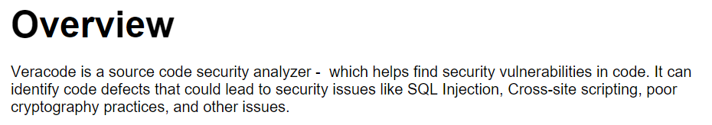
Veracode – Overview

Slide 98
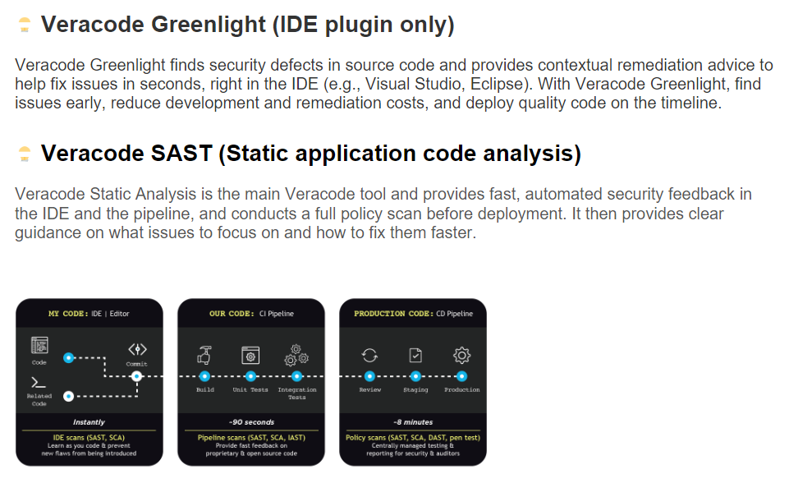
Veracode – What’s Used at BCG?

Slide 99
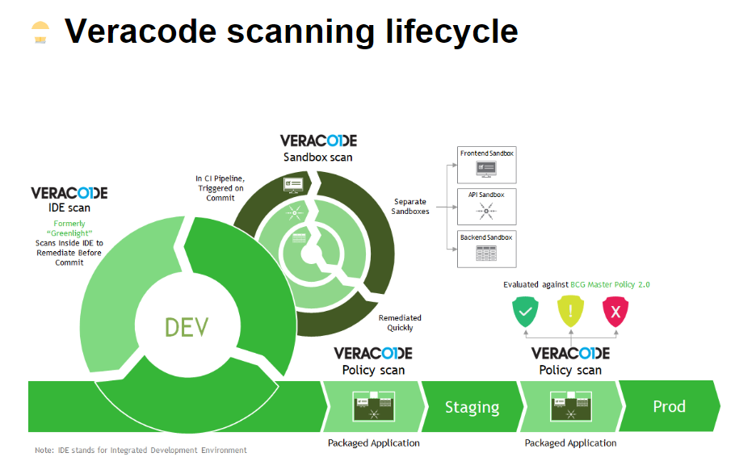
Veracode – Scanning Lifecycle

Slide 100
“Shift Left” Testing Approach
DevOps (and its CI/CD automation tools) are all about creating trust – in the tools and processes, and in the code itself. Key to this is testing.
A popular movement in DevOps is called “shift left” testing. It is an approach to software testing and system testing in which testing is performed earlier in the lifecycle (i.e. moved left on the project timeline)
This means developers are getting involved more in testing.
A common tradeoff to examine here: How long does a full set of tests take? How often are devs checking code into the branch that is tested? Do the tests take so long that code changes are getting backlogged? How to we prioritize tests in this situation?

Slide 101
DEMO:
Moving a feature MANUALLY through environments

Slide 102
WORKSHOP:
Group discussion: How would we use the tools of automation and feedback to improve this process?
Improving dev process with automation and feedback

Slide 103
What is DevSecOps?
DevSecOps stands for development, security, and operations. It's an approach to culture, automation, and platform design that integrates security as a shared responsibility throughout the entire IT lifecycle.
Commonly, security is only assessed on a product just before it gets shipped to the Ops environment. If there’s a severe vulnerability, a lot of work may need to be redone, at great expense.
DevSecOps means the whole team is thinking about security from the very start of the product’s life – even in the design stage.
This doesn’t just mean the security of the app itself – it also extends to the security of the infrastructure used to design, build, test and deploy the app.

Slide 104
Thinking Like a Hacker
Without descending a paralysis, we need to acknowledge that there is no digital system made that cannot be compromised, given enough time and resources.
Being security-conscious involves thinking like a hacker. Most will take the easiest, fastest route, and move on to easier targets if those routes fail.
Even if you are not a dedicated security pro, you need to know the fundamentals – and use them in your code and your infrastructure.

Slide 105
Prevention
Security of internet-connected systems and software is a constantly-changing area.
There are common prevention measures one can take, though.
Some of these involve infrastructure – where you use a third-party, examine their security processes very closely. Where you use your own infrastructure, work with security experts to configure it well.
Some of these involve the actual code of your application.

Slide 106
Secure Coding Practices
Secure coding is to design and develop software by avoiding the weaknesses that lead to security-related vulnerabilities by adhering to the specified security standards, and industry best practices.
This means you should:
1. Know your own security standards, developed in-house
2. Know the industry best practices, as well as the most common types of attacks

Slide 107
Common Attack Types
SQL Injection (Improper Neutralization of Special Elements used in an SQL Command)
Integer overflow
Buffer overflow (Buffer Copy without Checking Size of Input)
Uncontrolled format string
Missing authentication and authorization (Incorrect authorization)
Sensitive data exposure
Improper error handling

Slide 108
OWASP Standards
The Open Web Application Security Project (OWASP) is a nonprofit foundation that works to improve the security of software.
They regularly publish info on the most-used attack types for computer systems.
These are called the “OWASP Top Ten” Application Security Risks
They are also a source of useful reference material when assessing your own systems and designing security policies and coding practices.

Slide 109
DEMO:
SQL Injection Attack

Slide 110
Introduction to Test-Driven Development (TDD)

Slide 111
Thank you for joining today's course By participating in this course, you will:
Understand the value proposition
The value that test automation offers and tangible opportunities to realize that value
Explore key concepts
Deeper dive into practical topics and strategies that can be used to enable a successful test automation capability
Build a foundation for the future
How to build test automation into our “DNA” and use it to help shape our long-term success

Slide 112
The Case for Automated Testing

Slide 113
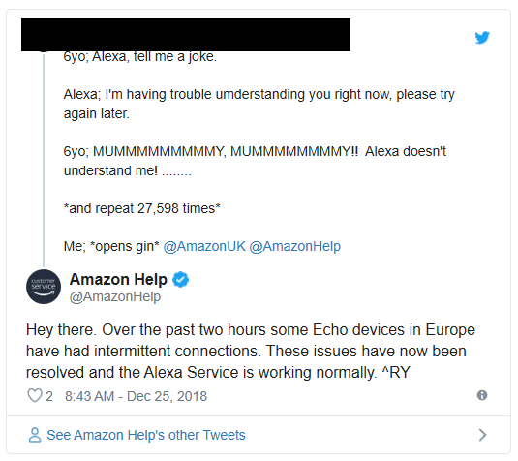

We expect today's technology systems to:
"Amazon this morning said its Alexa devices were among the holiday season’s best-sellers, particularly the Echo and Echo Dot. But the influx of new users setting up their devices for the first time on Christmas Day appeared to be more than Alexa could handle.
The service crashed briefly on Christmas, as thousands of new Alexa device owners tried to connect their Echo to Amazon’s servers around the same time."
Be available
Be responsive
Be secure
Work
And we want it YESTERDAY!
Source: https://techcrunch.com/2018/12/26/alexa-crashed-on-christmas-day/
Notes:
Whether it’s binging on our favorite Netflix show or getting directions to a new location, we expect to be able to turn to our smart TV’s, our computers, our phones and our tablets, and that they will just work

Slide 114
Automated Testing benefits all of us, regardless of role
Speed
Quality
Security
Faster delivery of product releases & gathering of feedback
Safe velocity
Increased capacity of product teams
Increased progress per sprint and efficiency
Improved productivity
Improved quality and agility
Attraction & retainment of top talent
Enhanced customer experience
Faster threat detection
Faster containment & mitigation
Standardized definition and use of security processes
Shifting left

Slide 115
Balancing Speed & Quality
Speed
Regulatory Compliance
Business Agility
Security
Quality
We want to move quickly to maintain a competitive advantage & increase profitability
We want to move safely to ensure we minimize rework cost & prevent monetary & reputational damage

Slide 116
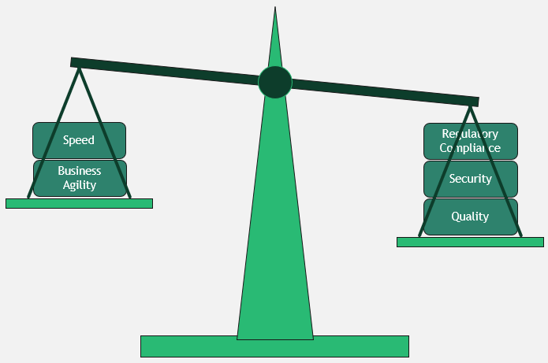
Slow, wholly-manual implementations are no longer sufficient To maintain our “edge”, we need to be able to move at the “speed of business”
Computers can run many operations at scale - repeatedly, quickly, & at the “push of a button":
Reuse of predefined & previously-vetted frameworks & libraries where possible to provide a “head start”
Automation of system deployment, including operational concerns like scaling & redundancy
Automation of the testing of our systems to enable testing of a multitude of different conditions as quickly as possible

Slide 117
Test automation tooling & frameworks can effectively exercise multiple test cases They use variable inputs to help ensure coverage of several, diverse edge cases in a repeatable manner
Quality
Through automation & proven test strategies, the goal is to find & fix quality issues as early as possible in the SDLC
Security
The security of our software systems is of paramount concern – security-focused test automation can help us verify many subtle variations of vulnerability
Automation
By building our test suites in alignment with system requirements (including regulatory & compliance requirements), we can automate validation of more than just “functional” concerns

Slide 118
Scenario & Discussion
SCENARIO
One of our engineering teams is responsible for a critical internal system used to manage and track all client engagements from start to finish (lead-to-cash). This is a custom-developed solution that has been built and evolved over the last 5 years.
Currently the team (and, by extension, the company) is suffering from several pain points that make it difficult to release new innovation and fix bugs as quickly as required. Ideally, we’d like to release once per day, but due to the current issues, we are able to release once per month (at best). When changes are introduced, the QA team has to “slog” through a large number of manual tests that lead to very slow regression cycles. Furthermore, the team would like to leverage DevOps principles like “fail fast” and “continuous feedback/improvement,” but the current development process can’t support it and is unable to provide us with data on the efficiency of our processes.
A strong need for more agile execution has been identified and data suggests that agile could improve our delivery and lower our costs significantly. However, because of the “heavy lift” associated with current state, it is difficult to size and plan in “bites” small enough to support agile.
GROUP DISCUSSION
10 minutes
Quickly catalog and distill the set of foundational challenges this team is experiencing with the current process
Discuss how test automation may help solve some of these issues
Notes:
Plan-of-attack:
- No breakout rooms
- 5 minutes of time for introspection
- 5 minutes of time for open discussion (chat or off mute)
Ryan will prepare some perspectives to help elicit input if we're struggling to get participation
JIRA current test process – manual testing and verification of all plugins, projects, artifacts (stories, epics, attachments, etc.)
Automated testing of the above and confirm no regression bugs within 1-2 hours instead of days/weeks
- If good discussion is happening, will allow it to continue past the 10 minutes (15 minutes max)

Slide 119
Given the different nuances of maintaining SaaS systems, where does automated testing “fit”?
Often largely an exercise in configuration management
Configuration change is still software change
Software changes need to be validated to ensure high quality and no impact on end users
Manual testing is an option, but automation breeds efficiencies and protection from regression
Notes:
Ryan will speak to some examples of SaaS applications that BCG uses (e.g., Workday, Jira, etc.)
- JIRA, Confluence, WorkDay, Palette, etc.
https://www.softwaretestinghelp.com/saas-testing/#:~:text=high%20standard%20applications.-,SaaS%20Platform%20Testing%20Best%20Practices,-After%20understanding%20the

Slide 120
Scenario & Discussion
SCENARIO
Your team is responsible for managing & maintaining configuration for the company’s CRM SaaS product. This product is considered a Tier-0 service as business operations are blocked if the service is down. Recently, the company implemented a new Single Sign-On (SSO) system for federating AuthN/AuthZ across the enterprise. The CRM SaaS product needs to have updated configuration applied in order to correctly integrate with SSO and ensure service interactions & operations are properly secured.
Additionally, the SaaS vendor recently added support for integration with a timekeeping system used by the employees at the company for tracking project activities & timesheets. To implement the desired integration between the timekeeping system & the SaaS product, new configuration needs to be applied to link the two systems & enable an end-to-end dashboard view of client engagement activity.
The decision is made to apply both sets of configuration updates as part of a single deployment.
GROUP DISCUSSION
10 minutes
Quickly catalog and distill the set of foundational challenges this team is experiencing with the current process
Discuss how test automation may help solve some of these issues
Notes:
Plan-of-attack:
- No breakout rooms
- 5 minutes of time for introspection
- 5 minutes of time for open discussion (chat or off mute)
- Ryan will prepare some perspectives to help elicit input if we're struggling to get participation
- If good discussion is happening, will allow it to continue past the 10 minutes (15 minutes max)

Slide 121
Testing Principles

Slide 122
Common testing strategies in modern test automation
Test-Driven
Development
Behavior-Driven Development
Data-Driven
Testing
Testing components in isolation (unit testing)
Using "mocked out" dependencies
Theory is that comprehensive quality is defined by quality of the units that compose the whole
"White box" testing
Ties tests directly to business scenarios and business outcome
Seeks to validate software quality from the perspective of user behavior
"Black box" testing
Uses (and reuses) a smaller set of test cases, leveraging tables with multiple variations of test data that can be automatically run through the test logic & system under test
Can help provide significant test coverage with less test code, as we repeatedly vary the inputs (and expected outputs)
There are multiple methodologies available for automated testing –
the chosen approach is likely not an "either-or" but a "both-and"
Notes:
Unit testing – testing components in isolation (using mocks to support)
Clean code/clean test – also a la “Uncle Bob”
Red, Green, Refactor – write tests while we code (when possible) / cyclical
Testing not just as an afterthought but a driver

Slide 123
Benefits to be experienced with automated testing
Greater shared success
(as tests can be tied to requirements)
Cleaner code
Guaranteed system documentation
Improved quality
Reduced fear
Improved regression protection
Greater streamlining to the approach
(small bites, avoidance of premature optimization, structured flow)
Discussion | Which of these benefits resonate most with you?
Notes:
Clean code means
- Loosely-coupled
- Well architected
- Testable
- Maintainable
- Stable
- Quality & performant
You pass the tests, you meet the requirements

Slide 124
Test-Driven Development (TDD) and the 3 Laws
1
2
3
The First Law
The Second Law
The Third Law
“You are not allowed to write any production code until you have written a unit test that fails due to its absence”
“You are not allowed to write more of a unit test than is sufficient to fail, and failing to compile is failing”
“You are not allowed to write more production code than is sufficient to cause the currently failing test to pass”

Slide 125
TDD Options
OPTION 1
Follow TDD in its “purest” form
OPTION 2
Don’t test (or only manually test)
Often companies opt for somewhere in between:
Unit testing
Automated
Clean code (and clean tests)
Red, Green, Refactor
Testing should lead to readable/more maintainable code
Notes:
Unit testing – testing components in isolation (using mocks to support)
Clean code/clean test – also a la “Uncle Bob”
Red, Green, Refactor – write tests while we code (when possible) / cyclical
Testing not just as an afterthought but a driver

Slide 126
Understanding TDD
Scenario: Determine discount based on purchase volume
Invoicing Module
Volume Input
SaaS Module
SaaS module is external service defining and enforcing business rules
Several levels of discount based on purchase volume ranges
Need to verify that the invoicing module operates correctly with the different levels of discount
What if the call to the SaaS module fails?
Tie test cases directly to specific business requirements (e.g., each discount level)
Write just enough code to pass the tests
By extension, have written just enough code to meet the business requirements
Mocking enables tight control over what gets returned from the downstream dependency, including any error conditions
Result is verified quality when built and automated regression testing against future changes
Notes:
For example:
- Purchase 1000+, discount of 20%
- Purchase 500 – 999, discount of 15%
- Purchase 100 – 499, discount of 10%
- Purchase < 100, no discount
Just enough is important – code is expensive to create and maintain. We should seek to minimize the code we write because it helps minimize the set of things that could go wrong.
Mocking – able to "force" the return of each level of discount to validate how invoicing operates; also able to "force" the return of an error to test error handling. Without mocking, you would have to ensure all necessary test data and conditions are in place to ensure return of what you need for your test as part of an end-to-end call. Probably not possible is SaaS module is owned by a third party.
With automated regression testing, as the invoicing module grows and changes, you'll be able to quickly see any resulting breaks at the push of a button.

Slide 127
Best practices with TDD
TDD supports the following best practices:
Don’t commit to a methodology, commit to impact and a positive result
Ensure that the engineering team has a clear understanding (and practice) for unit vs. integration testing
Automated testing is code – just like application code – estimate and plan accordingly
Find the right % of test coverage – quality & quantity!
Notes:
Ryan will speak to BCG's use of SonarQube to help measure test coverage and gate deployments – ensuring all tests pass, minimum coverage. Helps promote accountability.
BCG has a tool called SonarQube which helps teams to:
Ensure code quality (potential issues with code that is written and following best practices)
Assesses unit test coverage (quality gate) which ensures we are following TDD and adhering to DSO guardrails put in place
Assess code security and best practices with protecting data

Slide 128

To be effective, automated unit tests need to follow FIRST:
Note: This applies most appropriately to TDD given the volume of tests expected with unit testing.
F
I
R
S
T
Fast
Independent
Repeatable
Self-validating
Timely
or they won’t be executed
i.e., minimal dependencies between tests (keeps them simpler)
i.e., every run against unchanged code should operate the same
i.e., Boolean output (pass or fail)
if not first, early and often
Notes:
In “Clean Code”
Fast or they won’t get run
Independent – no dependence between tests
Repeatable – every run should operate the same every time
Self-validating – Boolean output (either pass or fail); single logical assert
Timely – if not first, early on

Slide 129
Automated Testing Frameworks & Methodologies

Slide 130
Testing in the SDLC
Quality gates guard against moving software defects forward
The Software Development Lifecycle (SDLC) calls out an explicit “Test” phase.
However, to be most effective testing should be continuously applied at multiple phases throughout the development & delivery workflow.
The goal is to find issues ASAP & address them before they make their way to later stages (where more expensive to fix).
Notes:
Scenario: We are rolling out several critical new features of an existing software platform. Two options – 1) we wait until all critical features have been implemented, and then we test all using "big bang", or 2) we test each feature as it's completed (and, in fact, we test while it's being completed). Option 2 allows us to leverage parallel workstreams, keeps the work to fix any discovered issues in "bite-sized" increments, and helps to minimize rework since defects are not allowed to move forward (we limit the "blast radius").
Ryan will again reference some of the quality gating tools used at BCG.

Slide 131
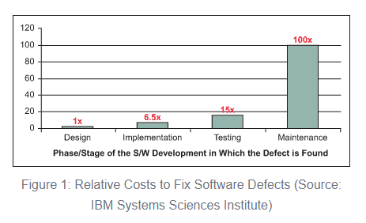
Relative Cost for Finding & Fixing Bugs
Bottom line? The sooner, the cheaper!
Source: https://www.isixsigma.com/tools-templates/software/defect-prevention-reducing-costs-and-enhancing-quality/

Slide 132
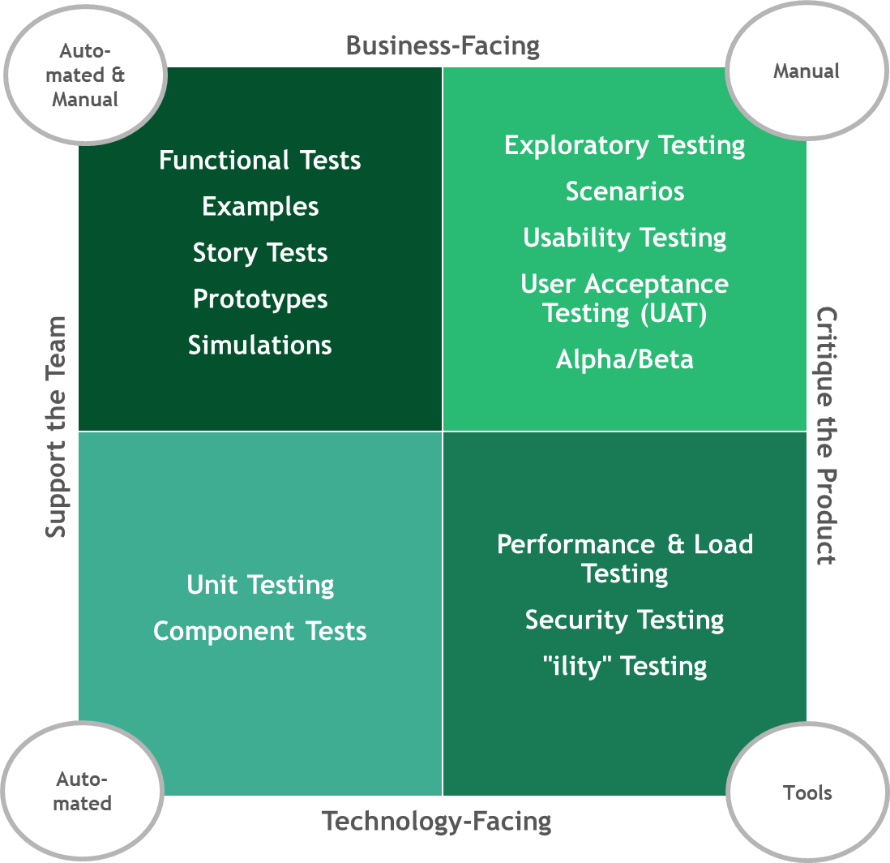
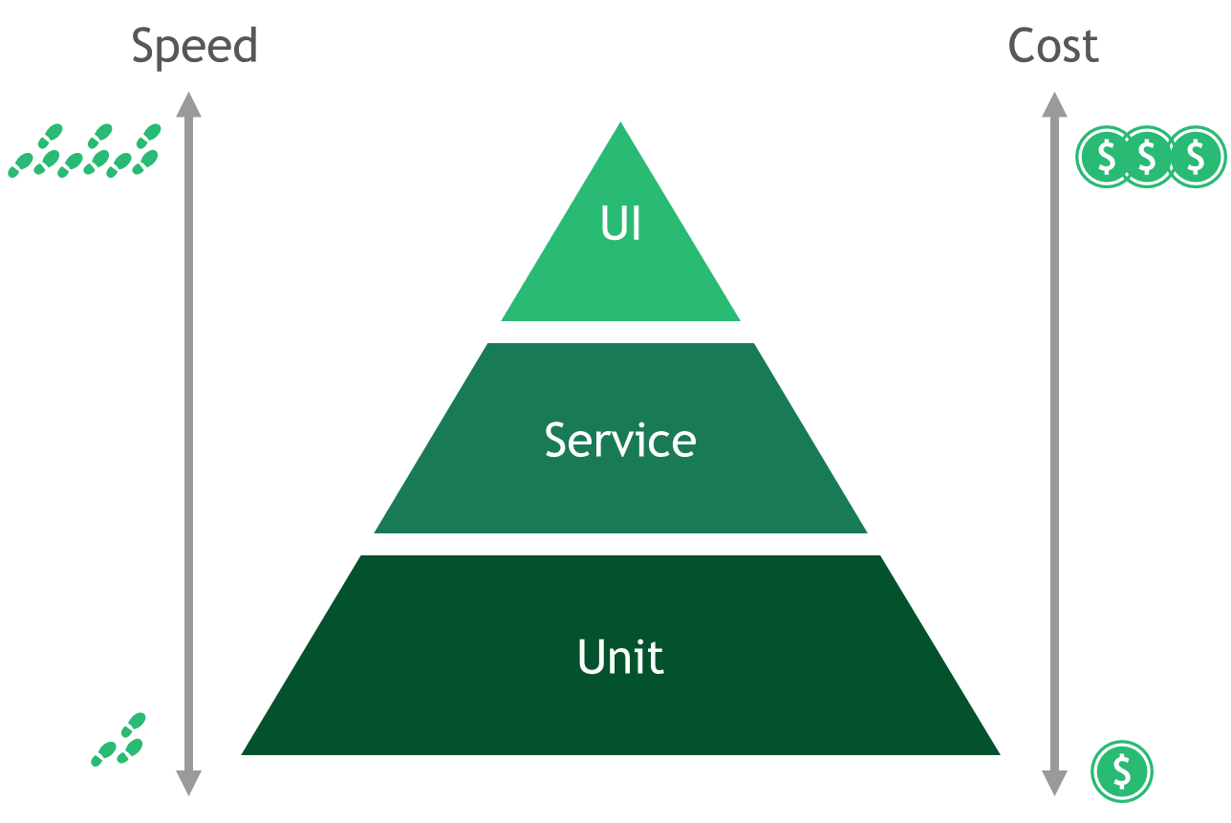
Selecting the testing approach that addressing the right, varying needs
Testing Quadrant
Provides a methodology for effectively balancing business and technical concerns
Accounts for need for both manual and automated tests
Test Pyramid
Recognizes the need for both manual and automated tests
Seeks to help organizations focus on value add

Slide 133
Using the Agile Testing Quadrant
Auto-mated & Manual
Manual
Business-Facing
Exploratory Testing
Scenarios
Usability Testing
User Acceptance Testing (UAT)
Alpha/Beta
Functional Tests
Examples
Story Tests
Prototypes
Simulations
Support the Team
Critique the Product
Unit Testing
Component Tests
Performance & Load Testing
Security Testing
"ility" Testing
Auto-mated
Tools
Source - https://lisacrispin.com/2011/11/08/using-the-agile-testing-quadrants/
Technology-Facing

Slide 134
Testing Quadrant
Business Facing
Confirm the external quality of the product
Critique the Product
Support the Team
Focused on evaluating overall product quality
How will software that meets the functional requirements perform (on multiple levels) when deployed to production?
Ensuring that Quality of Service (QoS) are met
Focused on supporting the teams that underpin the product & its delivery
Goal is to help guide the quality of the product & prevent functional defects from making their way into production
Technology Facing
Source - https://lisacrispin.com/2011/11/08/using-the-agile-testing-quadrants/
Maintain the internal quality of the application
Notes:
Ryan will talk about one of the goals being to free up teams' capacity by leveraging test automation, so they have time to focus on tests for important Quality-of-Service (non-functional) testing.
Many teams are so focused and fully consumed with manual testing that many other non-functional and critical test phases are neglected: exploratory, performance, cross-browser/platform, UAT, A/B, security, stability, scalability, etc.
Implementing test automation frees up capacity from the QA team to perform these exercises, which can often find those hard-to-identify defects before they reach production.

Slide 135
At times, without vigilance, we may find that our software testing resembles an ice cream cone rather than a pyramid
Automated E2E Tests
Integration Tests
Unit Tests
Source - https://alisterbscott.com/kb/testing-pyramids/

Slide 136
Test Pyramid
Speed
Cost
UI
Service
Unit
Source - https://martinfowler.com/bliki/TestPyramid.html

Slide 137
Test Pyramid
UI
Test functionality from the perspective of the person using the app
Service
Test multiple functions together to verify coordinated bundles of logic
Unit
Test discrete units of code in isolation from others
Source - https://martinfowler.com/bliki/TestPyramid.html

Slide 138
Test Pyramid
Given this comparison, teams tend to try and favor more (in terms of quantity) unit tests vs. UI tests
Speed
Cost
UI
Indicates how quickly the different test types are expected to execute
Service
Indicates how costly the execution of each type of test is expected to be (over time)
Unit
Source - https://martinfowler.com/bliki/TestPyramid.html

Slide 139
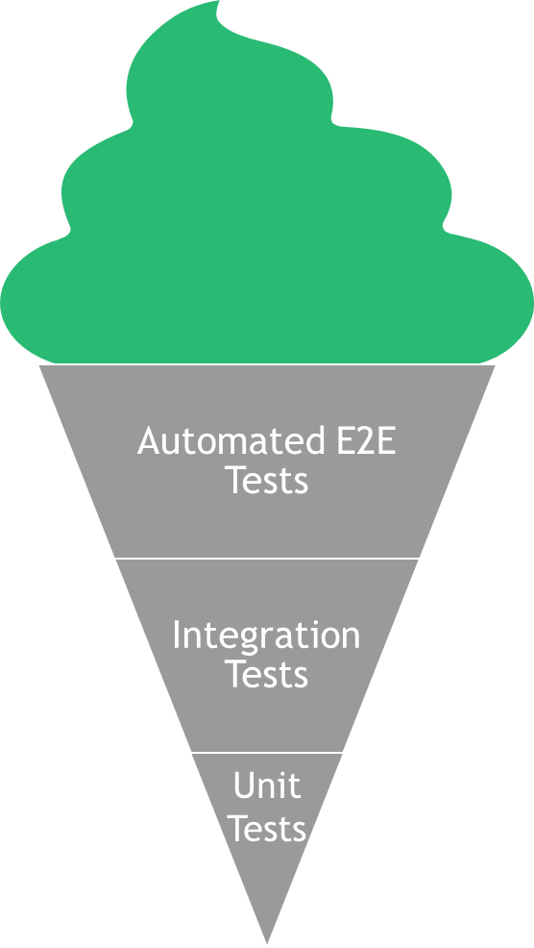
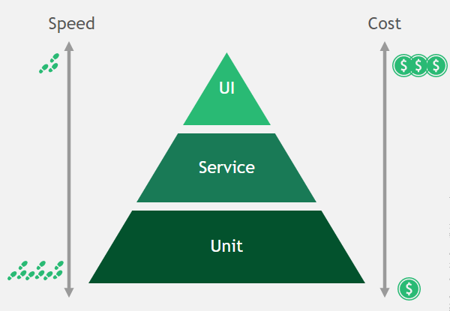
Reflection
What are some of the root causes of why we sometimes shift from the pyramid to the ice cream cone?
During project execution, what are some specific warning signs we can look for that will alert us to a trend towards that shift?
What are some practical steps we can take to move from the ice cream cone to a proper testing pyramid?

Slide 140
Managing Software Quality

Slide 141
Using Test Coverage to evaluate the completeness & effectiveness of our tests
The What
The How
Measurement mechanisms are built into many languages & development frameworks
These tools analyze source code under test against automated test runs, identifying source code that is covered (exercised by one or more tests) vs. not covered (excluded from any test)
Ranges from 0 – 100%, and the higher the number, the better the coverage
A low test coverage percentage indicates a deficiency in automated testing
Test coverage measures are often integrated into CI/CD pipelines, failing the build if a minimum level of coverage has not been achieved
Notes:
In presentation, talk about 80/20 rule – not just about the number but about focus on what's most important. 20% of the code often causes 80% of the bugs. Focus on testing what's most critical – not just quantity but also quality.

Slide 142
Wrangling “Technical Debt”
Tactics to mitigate technical debt:
Find opportunities to pay down debt as part of a future enhancement
Remove debt when modernizing a legacy system – don’t simply do a “balance transfer” when building the replacement
Embrace pay down of technical debt as a regularly-planned activity within your sprints (if possible)
Involves borrowing from the future to address the immediate
Manifests as choosing to go with a sub-optimal solution to move a project forward, instead of spending the time to build out the optimal approach
Results in higher compounding costs in the long-run (e.g., future development cost, long-term maintainability, speed, quality, etc.)
20-30%
of sprint capacity, ideally, should be allocated for bug fixes, automation improvement, POCs, etc.
Discussion | How can Product Owners and other team leaders help reduce technical debt?

Slide 143
What if we wrote our tests first?
Test Driven Development reverses the usual
Devs have to devise a test that will verify correct operation of a function before they even write the function
This forces you to write functions that “do one thing, and do it well”
Notes:
INSTRUCTOR NOTES:
REVIEWER COMMENTS:
PB: Question: When should you consider Test Driven Development?

Slide 144
Test Driven Development – basic sequence
Write a unit test for the function you’re about to create
Run the test – it should fail
Write the function
Test it
If it fails, re-examine your test and change it if your logic was wrong
Otherwise, refactor your function until it passes
Write another test - repeat
Notes:
INSTRUCTOR NOTES:
REVIEWER COMMENTS:

Slide 145
DEMO
Demo TDD with a new test, followed by creation of a new function, all in the reference application
Test Driven Development
Notes:
INSTRUCTOR NOTES:
REVIEWER COMMENTS:

Slide 146
LAB
Practice TDD by thinking of a function to add to the reference application (see instructor for ideas), then writing and refactoring it until the test passes
See instructor for any help needed in designing the test or the function
Test Driven Development
Notes:
INSTRUCTOR NOTES:
REVIEWER COMMENTS:
PB: Similar to previous Lab comments: layout steps/Process for the lab

Slide 147
Unit Testing Frameworks
Notes:
INSTRUCTOR NOTES:
REVIEWER COMMENTS:

Slide 148
Purpose of a unit testing framework
Help you write and run unit test
Provide test reporting
Manage collections of unit tests
Implement testing strategies that vary according to testing needs
Notes:
INSTRUCTOR NOTES:
REVIEWER COMMENTS:

Slide 149
Popular unit testing frameworks for Python
PyTest
Robot
Unittest (we will use this for our work)
DocTest
Nose2
Notes:
INSTRUCTOR NOTES:
REVIEWER COMMENTS:

Slide 150
Where does a unit test come in the development cycle?
VERY IMPORTANT FACT: Unit tests are NOT executed on a running instance of your application. They are run using ONLY your source code
This means they can be run before you use valuable resources to build and deploy your app, catching problems early
Notes:
INSTRUCTOR NOTES:
REVIEWER COMMENTS:

Slide 151
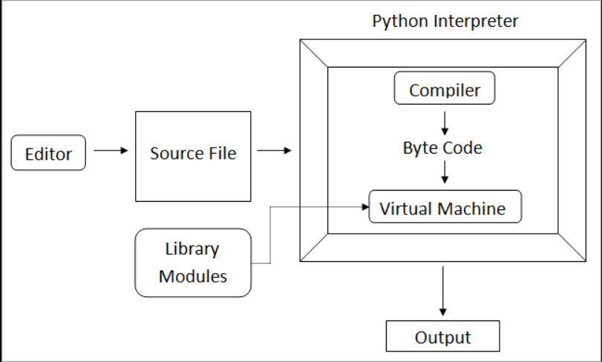
How does unit testing work under the hood?
Notes:
INSTRUCTOR NOTES:
REVIEWER COMMENTS:
PB: Instructor notes are needed to discuss this slide

Slide 152
Writing Unit Tests in UnitTest
Notes:
INSTRUCTOR NOTES:
REVIEWER COMMENTS:

Slide 153
Features of UnitTest
Less boilerplate code that other libraries/frameworks
Enables state and dependency management via “fixtures”
Allows test filtering, tailoring test runs to your needs
Provides for test parameterization
Easily extended
Notes:
INSTRUCTOR NOTES:
REVIEWER COMMENTS:

Slide 154
PyTest: Managing state for your test
We often need collection of objects, in a specific state, for our tests
We can use a “fixture” in PyTest to create and shape data to our needs – and then use that data structure across multiple tests
Notes:
INSTRUCTOR NOTES:
REVIEWER COMMENTS:

Slide 155
DEMO
Create a PyTest fixture and use it in two unit tests
PyTest Fixture
Notes:
INSTRUCTOR NOTES:
REVIEWER COMMENTS:

Slide 156
LAB
Create a PyTest fixture and use it in two unit tests
PyTest Fixture
Notes:
INSTRUCTOR NOTES:
REVIEWER COMMENTS:
PB: Similar to previous Lab comments: layout steps/Process for the lab

Slide 157
PyTest: Categorizing test
We may not always want to run every test – some might take too long for our situation, for example
We can control which tests are run by tagging them, and running only matching tests
Notes:
INSTRUCTOR NOTES:
REVIEWER COMMENTS:

Slide 158
DEMO
Tag a subset of our tests and show test runs on all tests/tagged tests
Tagging Tests
Notes:
INSTRUCTOR NOTES:
REVIEWER COMMENTS:

Slide 159
LAB
Tag a subset of your tests and perform test runs on all tests/tagged tests
Tagging Tests
Notes:
INSTRUCTOR NOTES:
REVIEWER COMMENTS:
PB: Similar to previous Lab comments: layout steps/Process for the lab

Slide 160
PyTest: Duration reports
PyTest reports include a built-in duration report
This helps you triage which tests to exclude if you need to speed up your builds
Notes:
INSTRUCTOR NOTES:
REVIEWER COMMENTS:

Slide 161
DEMO
Run a duration report on our tests. Change the tag on a long-running test to exclude it as needed. Re-run the tests, excluding that test.
Duration Report
Notes:
INSTRUCTOR NOTES:
REVIEWER COMMENTS:

Slide 162
LAB
Run a duration report on Your tests. Change the tag on a long-running test to exclude it as needed. Re-run the tests, excluding that test.
Duration Report
Notes:
INSTRUCTOR NOTES:
REVIEWER COMMENTS:
PB: Similar to previous Lab comments: layout steps/Process for the lab

Slide 163
Distributed Version Control and Git

Slide 164
Git
What is it?
Open-source distributed version control system
Takes “snapshots” of an application folder as changes occur
Includes both a local and remote component
Changes are local and are synced with remote as needed
Keeps a log of history of changes and allows return to previous version if required
Available at https://git-scm.com/ for download & installation

Slide 165
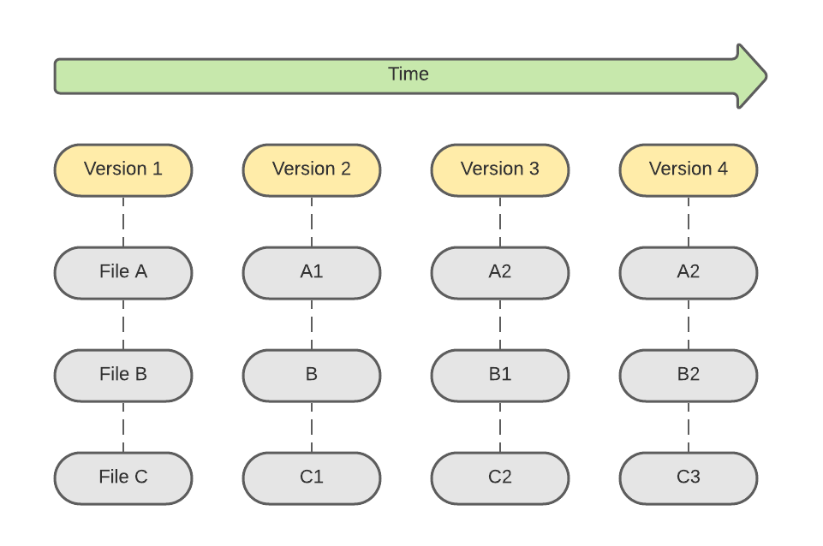
Check-ins Over Time in Git
Other version control systems track a running list of differences in each file over time
Git keeps snapshots of the entire folder at each check-in over time
Uses checksums to verify that contents of snapshot not tampered with

Slide 166
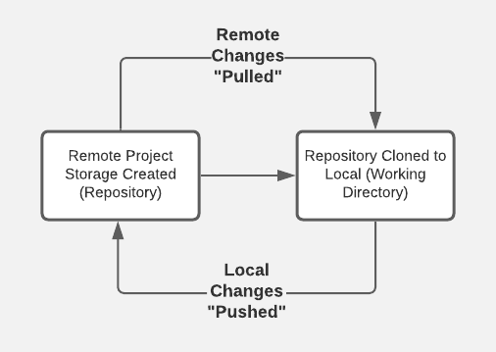
Typical Workflow
Over time, local is refreshed periodically from remote to absorb changes from other devs on the team
3
Remote storage location created (e.g., on github.com)
Branch created locally (or “checked out”) and pushed upstream to remote repo
1
2
4
Over time, changes in local are persisted to remote (checked in); when feature work complete, a PR (Pull Request) is submitted to request merge of branch to mainline
NOTE: Also, able to initiate repo creation from local command-line
Notes:
github.com is a site used to host remote GitHub repositories for access over the Internet; there’s also an Enterprise version that provides storage isolated to an organization

Slide 167
The Three Git States
Modified
File changed
Not yet committed to local database
Staged
Modified file marked for inclusion in next commit snapshot
Committed
Includes a short message describing contents of the commit
Persists current snapshot (including staged files) to local database
Can be selective about which modifications get staged
Notes:
Local database in this case is the .git directory that is available in every Git working directory

Slide 168
Demo
Notes:
Demo will be interweaved with the upcoming slides (toggle between slides & demo)
Demonstrate:
Cloning a repository
Contents (including hidden .git folder)
Talk about .gitignore and purpose – show https://www.toptal.com/developers/gitignore
Creating a new branch
Push branch upstream
Regular pull of updates from remote
`git status`
`git add` (staging)
`git commit` (commit)
Push of local updates to remote
Command-line and VS Code
Demonstrate:
Initiating creation of repo locally from command-line

Slide 169
Configuring Git
git --version to confirm Git is installed and to check version
git config --global user.name “<username>” to set username
git config --global user.email “<email>” to set user email address
File changes will be identified in Git history using this information

Slide 170
Configuring Git
Use git config --list to see all configuration settings
Use git config <setting name> to view a specific setting
For example, git config user.email

Slide 171
Create a Repository
Public or private repository can be created with hosting service (e.g., GitHub)
To link with local snapshot of remote repo, have a couple of options:
Initialize local from command line, add files locally, add/push to remote
Use URL from remote to pull to local via clone

Slide 172
Push to Remote
Create and/or navigate to target folder at local
With an existing repo at hosting provider (e.g., GitHub), execute the following:
echo “# <initial README.md text>” >> README.md
git init
git add README.md
git commit -m “<commit message>”
git remote add origin <HTTPS URL to repository>
git push -u origin main

Slide 173
README.md
echo “# <project title>” >> README.md creates new README file
Usually, a Git repo will include a “markdown” file with info about the repo
Markdown syntax is used to apply formatting characters to raw text

Slide 174
README.md
When displayed in “markdown” reader, formatting is applied
For example, “# “ in the echo statement formats text as a header
Cheat sheet for markdown syntax at https://www.markdownguide.org/cheat-sheet

Slide 175
git init
git init initializes local repo using configuration template
After executing, folder recognized as local Git repository

Slide 176
git add
git add README.md “stages” the README.md file for commit in Git
Reminder – files in Git can be in 1 of 3 stages:
Modified – file changed but not yet staged or committed
Staged – file ready for commit
Committed – file changes persisted to local repo; ready for potential push to remote

Slide 177
git commit
git commit -m “<commit message>” persists staged files to local repo
-m flag used to specify message to attach to current commit snapshot
At this stage, file changes are persisted locally but not yet remotely

Slide 178
git remote add
git remote add origin <HTTPS URL to repository> used to add remote
Configures link between local and remote at hosting provider
If target remote is a private repo, will required additional security
Can use a personal access token (with GitHub) or leverage SSH

Slide 179
git push
git push -u origin main used to persist branch and changes to remote
-u used to specify “upstream” (or remote) branch target
origin is reference name for remote repo
main is name of branch to push
Again, if private repo, will require additional security to complete

Slide 180
git clone
For initial pull of repository from remote (e.g., GitHub) to local, use git clone
Create and/or navigate to folder where new repo folder should exist
Format is git clone <HTTPS URL to repository>

Slide 181
git clone
If repo is private, user will need to be granted access
Public repos can be cloned without additional access being granted
Upon completion, new folder will contain local snapshot of remote repo

Slide 182
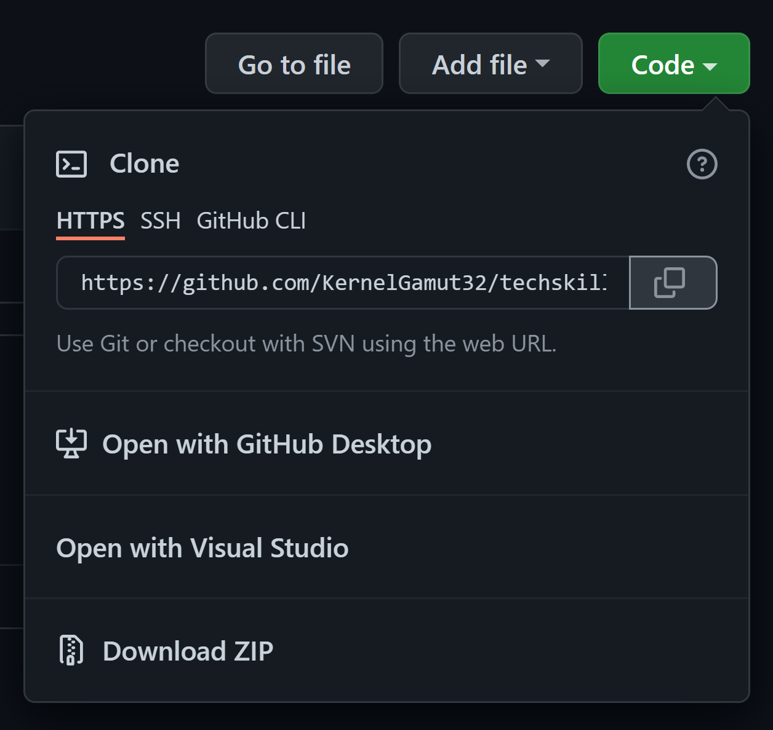
git clone
On repo “home page” in GitHub, clone repository URL can be found/copied using the “Code” dropdown

Slide 183
git pull
Local repository can be refreshed from remote (as required)
Canonical use case is updating local version of shared branch with others’ changes
With branch checked out locally, use git pull origin <branch name> or git pull (which will default to currently checked out branch name)

Slide 184
Lab
Notes:
Creating a new repository in GitHub
Cloning that repository locally
Creating a new repository locally
Pushing that repository to remote
Use BCG exercise or https://docs.microsoft.com/en-us/learn/modules/intro-to-git/ + https://docs.microsoft.com/en-us/learn/modules/create-git-project/

Slide 185
Branching in Git
Branches provide segregated snapshots of the codebase for parallel workstreams
Often, branches created from mainline for development of a specific feature
Structured process used to merge branches back into mainline

Slide 186
Branching in Git
Use git checkout –b <branch name> in local working directory to create new branch
Use git push –u origin <branch name> to push branch to remote for tracking
git branch --list used to list existing branches

Slide 187
Branching in Git
git checkout <branch name> used to switch to different local branch
git fetch used to refresh local list with list of newly added remote branches

Slide 188
Making Code Changes
Checkout target branch for development
Make necessary code changes – including adds, updates or deletes
Use git status to see the state of files in the current branch

Slide 189
Making Code Changes
Use git add to stage changes for push to remote
Either git add <filename> or git add –A (for all updates in directory)
Use git status to check status of modified vs. staged artifacts

Slide 190
Making Code Changes
To unstage 1 or more files, use git restore --staged <file or wildcard pattern>
git restore --staged . used to unstage current directory
Use git add to restage

Slide 191
Pushing to Remote
Committed files are pushed to remote using git push
Format is git push origin <branch name> or git push (to push to currently checked out branch in remote)
User will need permissions on repo to push
May be prompted for credentials with hosting provider to complete

Slide 192
Pushing to Remote
To prep staged files for push to remote, use git commit
Format is git commit -m <commit message>
git status will reflect status change

Slide 193
Pull Requests
When feature complete and ready for merge, engineer submits pull request (PR)
Allows peer review of proposed changes
Usually governed by policies around number of required reviewers, successful build in branch before merge, etc.

Slide 194
Lab
Notes:
Creating a new branch on a cloned repository
Making changes to that branch
Pushing those changes to remote
Creating a pull request from those changes
Use BCG exercises or https://docs.microsoft.com/en-us/learn/modules/collaborate-with-git/

Slide 195
Merging in Git
Best practice is to favor multiple smaller PRs over a few larger ones
Helps reduce review risk and chances for conflicts
Also, helps to minimize “drift” between in-progress work and mainline
Notes:
Larger PR’s can last longer – over time, mainline is changing from other dev work. Keeping the 2 in sync and moving in smaller steps.

Slide 196
Merging in Git
The larger the PR, the longer it can stay open
Other features are being merged into mainline while development continues
If Git is unable to automatically merge and resolve multiple changes to the same file, results in a conflict

Slide 197
Merging in Git
Good practice to regularly refresh branch with pull from mainline
Helps to keep branch in sync with mainline
Allows developer to find and fix merge conflicts in the branch before submitting PR
Notes:
* Conflicts requiring manual intervention can be addressed before PR submission
* When PR is approved and merged, branch can be deleted

Slide 198
Managing Merge
With target branch checked out, use git merge to pull in updates
For example:
git checkout branch-name
git merge origin main

Slide 199
Managing Merge
Any merge conflicts will be called out on the command-line
Use git status and git diff to list merge conflict details
Manually update files to resolve and push changes to remote

Slide 200
Managing Merge
Once all conflicts have been resolved, run git merge once more
Do a final push to remote for the branch to refresh
To “cancel” merge, use git merge --abort

Slide 201
Managing Merge
Alternatively, many IDEs will help you automatically manage via UI

Slide 202
Demo
Notes:
Executing a merge
Encountering and managing a merge conflict
Show in Visual Studio Code (or similar)

Slide 203
Lab
Notes:
Executing a merge
Encountering and managing a merge conflict
Use BCG exercise or https://docs.microsoft.com/en-us/learn/modules/branch-merge-git/

Slide 204
Branching in Git

Slide 205

Branching Strategy
A consistent strategy for branching is important
Define a standard set of strategy components that enable:
- Simplicity
- Stability
- Efficient and repeatable releases

Slide 206
Feature Branches
Feature branches are branches created from the main branch
Use for new features as well as bugs
Helps with tracking evolution of software over time
Keeps developers’ parallel work separate
Use a consistent naming strategy for the branch (e.g., user-name/feature-name)

Slide 207
Use Pull Requests
Feature branch changes should be reviewed and merged via PR
Repo can be configured with a minimum number of reviewers to enable merge
Can also integrate build steps into the PR process so successful build is confirmed before merge
Keep PRs small

Slide 208
Protect Mainline
Mainline should be clean and kept up-to-date
Provides a stable, common starting point for developers creating feature branches from it
Use branch policies to protect mainline
Avoid direct merge there – use PRs instead

Slide 209
Developing in a Branch
The longer a feature branch exists (and the larger the amount of code changes it contains), the higher the likelihood of a merge conflict
To help minimize conflicts, a developer should keep their feature branch up-to-date with latest
Can be done by regularly merging mainline into the branch during development

Slide 210
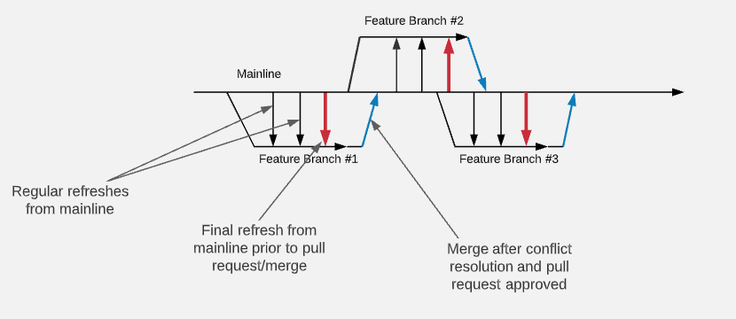
Developing in a Branch
Notes:
AKA trunk-based development

Slide 211
Managing Releases
Optionally, release branches can be used for managing releases of the software
Provides a point-in-time version snapshot
If bugs are found in a release, fixes need to be made in both release branch and mainline
Couple of options: fix in mainline and port to release branch or fix in release branch and backport to mainline
Notes:
Review https://bcg-ksg.atlassian.net/wiki/spaces/EP/pages/2571010054/GitHub+Branching+Strategies with attendees

Slide 212
What is Version Control?
Programs AND work practices that we use to track and control text documents
What documents? Source code - the text files we use to create our executable program
Helps facilitate multiple contributors on a project
Allows us to revert to previous iterations of code base as needed
Notes:
INSTRUCTOR NOTES:
REVIEWER COMMENTS:
PB: Who can give me an example?

Slide 213
The Past: Client/Server Version Control
Prior to 10-15 years ago, most version control used client/server model:
One computer (version control server) had all source code files; it was usually on-site
Client computers (devs) could “check out” a file with the server – that would lock the file to changes
When dev done with work, submits change to server
Once change is made, the file is unlocked for others to modify
Disadvantage: geographically distributed teams weren’t possible; multiple devs can’t work on the same file
Notes:
INSTRUCTOR NOTES:
REVIEWER COMMENTS:

Slide 214
The Present: Distributed Version Control
The source code files are distributed – a full copy of all files, and their entire history, exists on every developers’ computer
Multiple devs can work on the same file simultaneously – when they merge, a computer program will handle routine merge actions; merge conflicts are raised for human interaction
There are a few popular programs:
Subversion
Mercurial
Git
Git is by far the most popular
Notes:
INSTRUCTOR NOTES:
REVIEWER COMMENTS:

Slide 215
How Git Works
A “complete history” of all versions of the code is on every machine that contributes to that code
These collected versions are called “repositories”
IMPORTANT: A new “version” of a file doesn’t contain the full file contents – it just contains the DIFFERENCES between the previous version and the new version
These “diff” files are used to reconstruct previous versions of the code
This means the whole historical record takes up a LOT less space than if we stored the actual files
Notes:
INSTRUCTOR NOTES:
REVIEWER COMMENTS:

Slide 216
Git: Who Do You Trust?
If every computer working on a project has a repository (repo), and every repo has a complete copy of the history, whose repo should we use to initiate change?
Fun fact: ANY one of the repos can be used – after the change, we just tell everyone to sync up their repo with the one that just changed
This is NOT fun to manage. Instead, most teams create one “central” repo, and initiate changes to the code base there.
IMPORTANT: This idea of a “central” repo is only an idea, and needs to be kept true by process
This central repo is usually considered the “source of truth” as far as current state of the code base
Notes:
INSTRUCTOR NOTES:
REVIEWER COMMENTS:
PB: This is an opportunity to show the question first, solicit responses, then show/discuss the balance of text

Slide 217
Git: It’s Like the Wild West
There are no rules about how to set up and use Git. You can do basically anything with it as far as workflow
This means teams must decide what to do, and enforce it via common agreement and/or enforced practices
The most common pattern:
Set up one repo where no dev work gets done.
Consider that this is the “source of truth” repo.
All change initiates here.
Dev repos exist locally on dev machines.
To the dev repos, the “source of truth” repo is considered a “remote” repo
Notes:
INSTRUCTOR NOTES:
REVIEWER COMMENTS:

Slide 218
Working Locally with Git
Notes:
INSTRUCTOR NOTES:
REVIEWER COMMENTS:

Slide 219
Local Git Operations – Why Should We Care?
Why does version control matter on a local repo?
Should we use version control on a project where we will be the only contributor?
Notes:
INSTRUCTOR NOTES;
REVIEWER COMMENTS:
PB: Good opportunity to perhaps pose this with a multiple choice and tally responses

Slide 220
DEMO:
Demo version control on local files
Local Git operation
Notes:
INSTRUCTOR NOTES:
REVIEWER COMMENTS:
PB: Can some detail of the demo be provided here? I would believe CG would want to be seeing that

Slide 221
Local Git Operations – Create a Repo
.git folder
.gitignore folder
Notes:
INSTRUCTOR NOTES:
REVIEWER COMMENTS:

Slide 222
Local Git Operations – Creating Files
Not tracked by Git unless you specify it
Notes:
INSTRUCTOR NOTES:
REVIEWER COMMENTS:

Slide 223
Local Git Operations – Staging Changes
Track a file and stage any changes to it – a periodic “checkpoint” on your work
Notes:
INSTRUCTOR NOTES:
REVIEWER COMMENTS:

Slide 224
Local Git Operations – Committing Changes
Making some (or all) of your staged changes a permanent part of version history
Notes:
INSTRUCTOR NOTES:
REVIEWER COMMENTS:

Slide 225
LAB:
Create local repository and perform Git operations on local files
Local Git operation
Notes:
INSTRUCTOR NOTES:
REVIEWER COMMENTS:
PB: Need to create a summary of actions or something similar to explain the lab

Slide 226
Working with Remote Repos
Notes:
INSTRUCTOR NOTES:
REVIEWER COMMENTS
PB: Need a slide in front of this that sections this as Day 2 and reviews what was learned the day before and asks whether there are any questions.

Slide 227
Remote Repos – the “Source of Truth”
Relationship between local repos and remote repos
Deciding where to put remote repos
Danger of initiating changes to source code away from the primary remote repo
Notes:
INSTRUCTOR NOTES:
REVIEWER COMMENTS:
PB: Challenge question: What are the repercussions – dangers – of making changes away from the primary remote repo?

Slide 228
How to set up a remote repo for your local repo
Git commands
The value of an alias for your remote repos
Notes:
INSTRUCTOR NOTES:
REVIEWER COMMENTS:

Slide 229
Cloning a repo from remote to local
Git commands
Modern conventions for naming the primary branch on a repo
Notes:
INSTRUCTOR NOTES:
REVIEWER COMMENTS:
PB: Before moving to the next section, perhaps build a Knowledge Check question for the class to answer as a review. Then offer a brief break before starting the next section.

Slide 230
Git Workflows
Notes:
INSTRUCTOR NOTES:
REVIEWER COMMENTS:

Slide 231
What is a Git Workflow?
Arbitrary set of agreements about how to manage work on a distributed code base
Mainly address how to create and manage branches
Several popular approaches
Git Flow
GitHub Flow
GitLab Flow
Notes:
INSTRUCTOR NOTES:
REVIEWER COMMENTS:
PB: Hide your bullets and pose this as a challenge question first: Can anyone tell me what a Git Workflow is?

Slide 232
How does Git Flow work?
Proposed by Vincent Driessen in 2010: https://nvie.com/posts/a-successful-git-branching-model/
Very popular, although most dev groups tweak it a little
Driessen updated his thoughts on it in 2020; see the linked article
Notes:
INSTRUCTOR NOTES:
REVIEWER COMMENTS:

Slide 233
Pull Requests
Notes:
INSTRUCTOR NOTES:
REVIEWER COMMENTS:

Slide 234
Pull Requests
Code review – usually of proposed change to the primary branch in a repo
Ideally includes actually pulling changes onto the reviewer’s machine and executing the code
May be informal, or enforced by rules in the source control management platform
Notes:
INSTRUCTOR NOTES:
REVIEWER COMMENTS:

Slide 235
DEMO:
Show full workflow described in Git Flow article
Git Flow
Notes:
INSTRUCTOR NOTES:
REVIEWER COMMENTS:

Slide 236
LAB
Have students perform full workflow described in Git Flow article
Includes creating a PR and getting it approved by the instructor
Git Flow
Notes:
INSTRUCTOR NOTES:
REVIEWER COMMENTS:
PB: Similar to previous Lab comments: layout steps/Process for the lab

Slide 237




Thank you!
If you have additional questions, please reach out to me at:
erik-gross@pluralsight.com

